Slide 1

The 11T Dipole Magnet for HL-LHC
Holland @ CERN
F. Savary
CERN Council Chamber – 2 June 2016

Slide 2

OUTLOOK
Introduction
Main parameters of the 11T Dipole
The 11T Dipole Plan in the Timeline of HL-LHC
From technology demonstration to “final” design
Quench performance of MBHDP101
Challenges
Summary

Slide 3
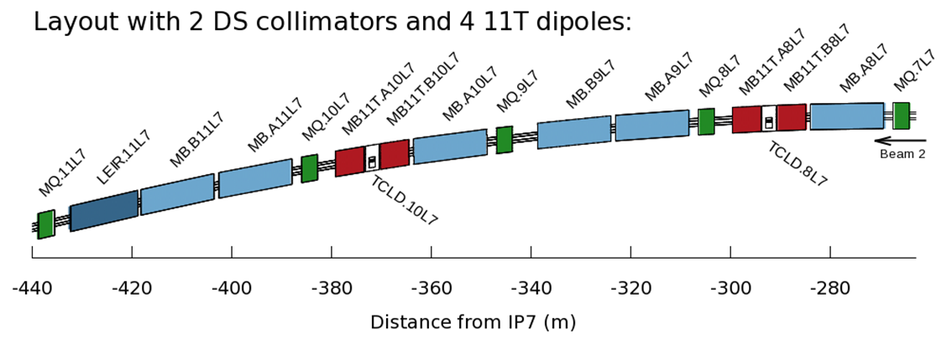
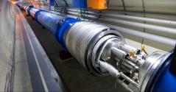
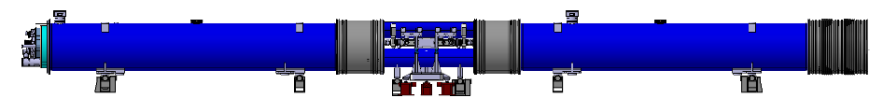
Introduction
Create space in the dispersion suppressor regions of LHC, i.e. a RT beam vacuum sector, to install additional collimators needed to cope with beam intensities larger than nominal
Collimators are needed in IP7 to absorb off-momentum particles/beam losses (proton operation)
Replace a standard Main Dipole by a pair of 11T Dipoles producing the same integrated field of 119 T·m at 11.85 kA
LS2
LS3
By-pass cryostat
15660 mm
11 T dipole cold mass
Space for Collimator
Interconnect

Slide 4
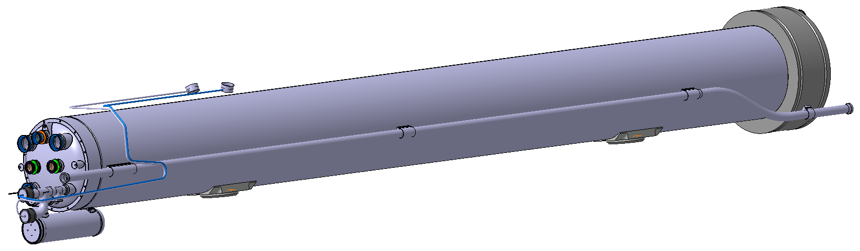
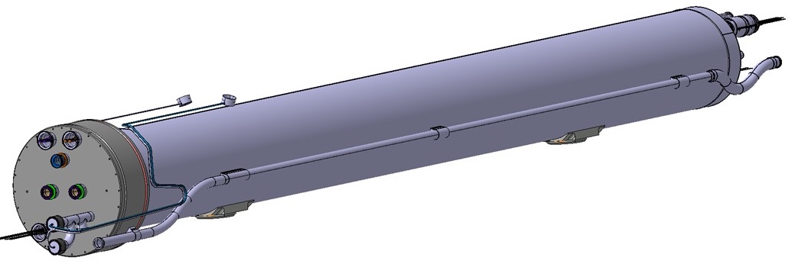
Definition of the cryo-assembly
LBH_A
By-pass cryostat
LBH_B
LMBHA
LMBHB

Slide 5
OUTLOOK
Introduction
Main parameters of the 11T Dipole
The 11T Dipole Plan in the Timeline of HL-LHC
From technology demonstration to “final” design
Quench performance of MBHDP101
Challenges
Summary

Slide 6
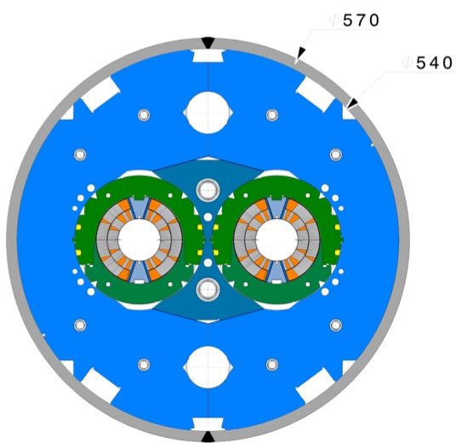

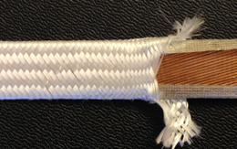
Main parameters of the 11T Dipole
Characteristic | Value | Unit
Aperture | 60 | mm
Distance between apertures at RT / 1.9 K | 194.52 / 194.00 | mm
Magnetic length | 5.307 | m
Coil length | 5.415 | m
Magnet length, between end plates | 5.799 | m
Cold mass assembly length | 6.252 | m
Operating temperature | 1.9 | K
Nominal operation current | 11.85 | kA
Bore field @ nominal current | 11.23 | T
Peak field @ nominal current | 11.59 | T
Stored energy/m at I_{nom} | 0.9663 | MJ/m
Cable bare width before reaction | mm | 14.7
Cable bare mid-thickness before reaction | mm | 1.25
Keystone angle | Degree | 0.79
Strand diameter | 0.700 ± 0.003 | mm
Number of strands per cable | 40 | -
Cable insulation thickness, before/after reaction | 0.150/0.110 | mm
  Mica tape, COGEBI FIROX®, 80 μm
  S2-glass braided on cable
  Epoxy resin CTD-101K

Slide 7
OUTLOOK
Introduction
Main parameters of the 11T Dipole
The 11T Dipole Plan in the Timeline of HL-LHC
From technology demonstration to “final” design
Quench performance of MBHDP101
Challenges
Summary

Slide 8
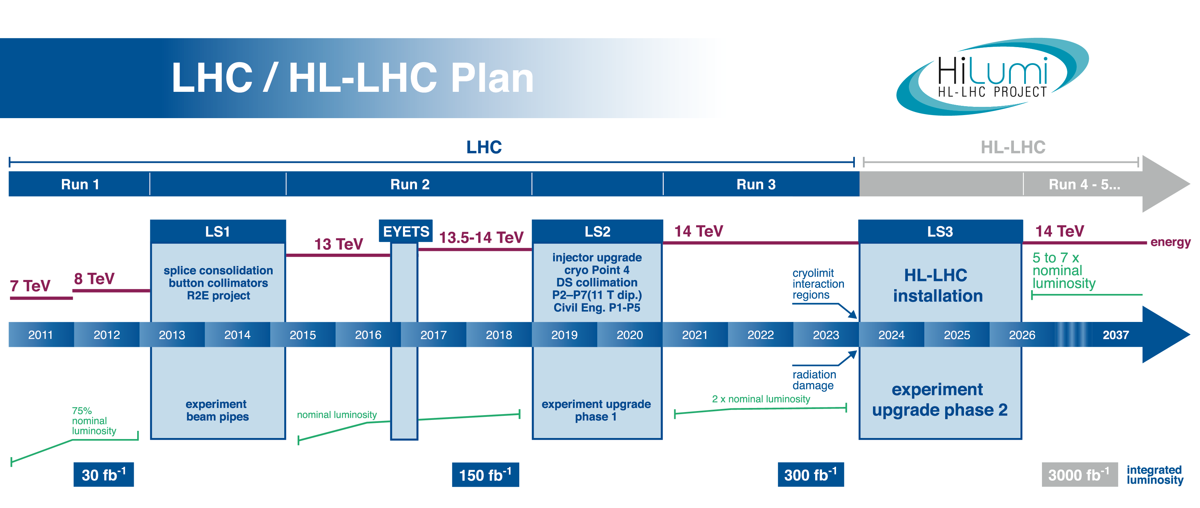
Timeline of HL-LHC
2 will be installed
during LS2 + 1 spare
2 will be installed
during LS3 + 1 spare
TODAY

Slide 9
OUTLOOK
Introduction
Main parameters of the 11T Dipole
The 11T Dipole Plan in the Timeline of HL-LHC
From technology demonstration to “final” design
Quench performance of MBHDP101
Challenges
Summary

Slide 10
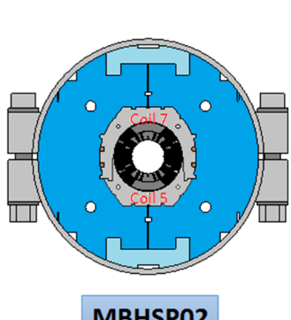
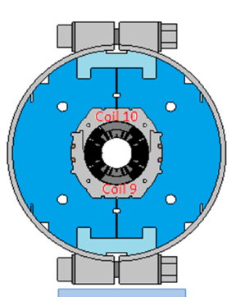
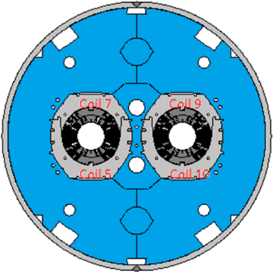

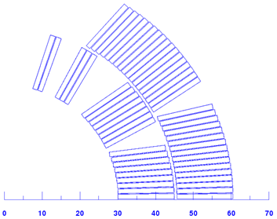
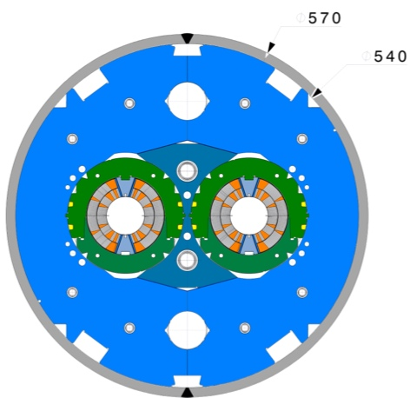
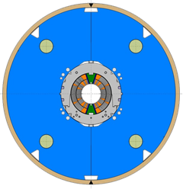
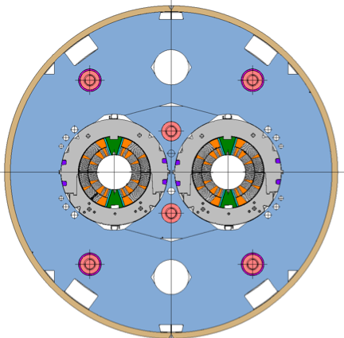
From technology demonstration to “final” design
Integrated pole concept @ FNAL
MBHSP01
MBHSP02
MBHSP03
MBHDP01
Same coil design
@ FNAL and CERN
as starting point
6 blocks – 56 turns
Removable pole concept @ CERN
MBHSP10X [RRP]
MBHSP20X [PIT]
MBHDP101
MBHDP102 [RRP] - 201 [PIT]
LBH_P001 [RRP] - 2 [PIT]

Slide 11
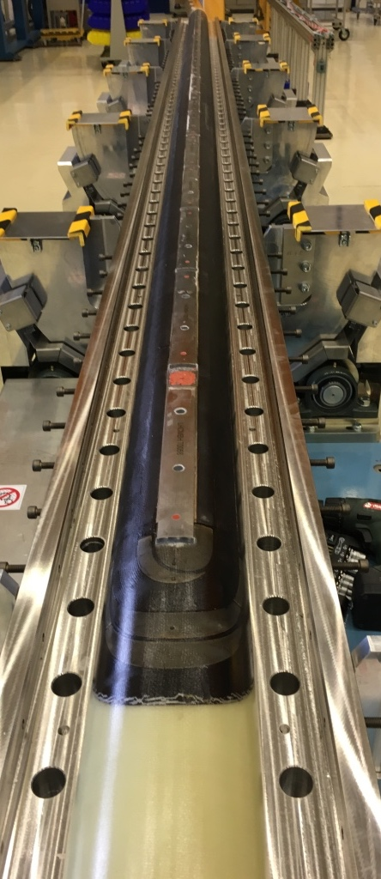
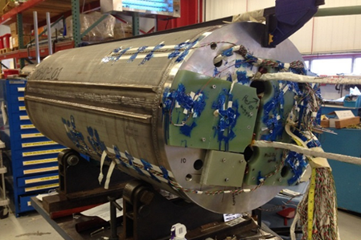
MBHDP101
MBHDP01
First 5.5 m long coils
made @ CERN

Slide 12
The 11T Dipole Plan in the Timeline of HL-LHC
2015 |  |  |  |  |  |  |  |  |  |  |  | 2016 |  |  |  |  |  |  |  |  |  |  |  | 2017 |  |  |  |  |  |  |  |  |  |  |  | 2018 |  |  |  |  |  |  |  |  |  |  |  | 2019 |  |  |  |  |  |  |  |  |  |  |  | 2020 |  |  |  |  |  |  |  |  |  |  |  | 2021 |  |  |  |  |  |  |  |  |  |  |  | 2022 |  |  |  |  |  |  |  |  |  |  |  | 2023 |  |  |  |  |  |  |  |  |  |  |  | 2024
J | F | M | A | M | J | J | A | S | O | N | D | J | F | M | A | M | J | J | A | S | O | N | D | J | F | M | A | M | J | J | A | S | O | N | D | J | F | M | A | M | J | J | A | S | O | N | D | J | F | M | A | M | J | J | A | S | O | N | D | J | F | M | A | M | J | J | A | S | O | N | D | J | F | M | A | M | J | J | A | S | O | N | D | J | F | M | A | M | J | J | A | S | O | N | D | J | F | M | A | M | J | J | A | S | O | N | D | J | F | M | A | M | J | J | A | S | O | N | D
 |  |  |  |  |  |  |  |  |  |  |  |  |  |  |  |  |  |  |  |  |  |  |  |  |  |  |  |  |  |  |  |  |  |  |  |  |  |  |  |  |  |  |  |  |  |  |  | LS2 |  |  |  |  |  |  |  |  |  |  |  |  |  |  |  |  |  |  |  |  |  |  |  |  |  |  |  |  |  |  |  |  |  |  |  |  |  |  |  |  |  |  |  |  |  |  |  |  |  |  |  |  |  |  |  |  |  |  |  | LS3
For LS2, Models, X-Section 1, RRP
For LS2, Prototype P1, X-Section 1, RRP
 |  |  |  |  |  |  |  |  |  |  |  |  |  |  |  |  |  |  |  |  |  |  |  |  |  |  |  |  |  |  |  |  | Series Production for LS2, X-Section 1, RRP
 |  |  |  |  |  |  |  |  |  |  |  |  |  |  |  |  |  |  |  |  | For LS3, Models, X-Section 2, PIT & RRP
 |  |  |  |  |  |  |  |  |  |  |  |  |  |  |  |  |  |  |  |  |  |  |  |  |  |  |  |  |  |  |  |  |  |  |  |  |  |  |  |  |  |  |  |  |  |  |  |  |  |  |  |  |  |  |  |  |  |  |  |  |  |  |  |  |  |  |  | Series Production for LS2-Spare and LS3, X-Section 2, PIT & RRP
* 2 cryo-assemblies for IP7
B8L7 & B8R7
* 1 spare cryo-assembly
* 2 cryo-assemblies for IP7 B10L7 & B10R7
* 1 spare cryo-assembly
Spare
available
in end 2021
Beginning of winding
Cold tests of LBH_P1 +
Cryo-by-pass + LBH__001
For LS3, Prototype LBH_P2,
X-Section 2, PIT
Beginning of winding
Beginning of winding

Slide 13
OUTLOOK
Introduction
Main parameters of the 11T Dipole
The 11T Dipole Plan in the Timeline of HL-LHC
From technology demonstration to “final” design
Quench performance of MBHDP101
Challenges
Summary

Slide 14
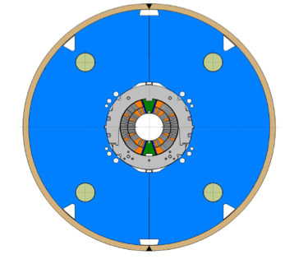
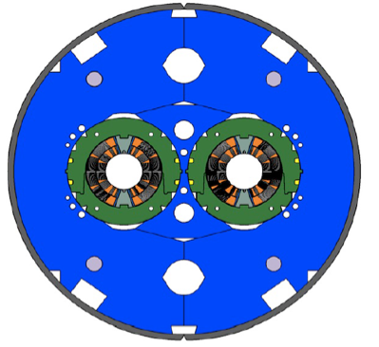
Quench performance of MBHDP101
MBHSP102
MBHSP103
MBHDP101
 | Maximum current reached (kA) | % I_{ss}
SP101 | 11.9 | 82
SP102 | 12.8 | 88
SP103 | 12.8 | 90
DP101 | 13.2 | 94
Holding current tests were performed, up to 10 hours at nominal current and 2.5 hours at ultimate current
Not a single quench was recorded during flattop or ramp down for all models!

Slide 15
OUTLOOK
Introduction
Main parameters of the 11T Dipole
The 11T Dipole Plan in the Timeline of HL-LHC
From technology demonstration to “final” design
Quench performance of MBHDP101
Challenges
Summary

Slide 16
How can Holland contribute to the 11T?
Legend:
We are covered
We need more suppliers
We desperately need suppliers
Item # | Description | Raw material | 2018 | Later | What is challenging
1 | Coil keys | AISI 316 L – DIN 1.4435 |  |  | Machining (accuracy & elasticity)
2 | End spacers | SLS – AISI 316 L – DIN 1.4435 |  |  | Metrology, electrical insulation?
3 | Saddles | Impregnated glass fiber as per IEC/EN 61212-3-1 EP-GC22 |  |  | 5-axes machining, GC22, accuracy
4 | Removable pole | TA6V annealed (Ti6Al4V; 3.7165) |  |  | Accuracy & material
5 | Wedges – precision profiles | Aluminum oxide dispersion strengthened copper (ODS) |  |  | Accuracy, material ODS
6 | Quench heaters | Polyimide – St.Steel – Copper |  |  | Flexible Printed Circuits
7 | Collars | YUS-130S (High Mn Steel) |  |  | Fine blanking, accuracy
8 | Collaring keys | AISI 316 L – DIN 1.4435 |  |  | Accuracy
9 | Yoke laminations & inserts | Low carbon steel |  |  | Fine blanking, accuracy
10 | Heat exchanger tube | Oxygen Free Cu – UNS C10200 |  |  | Cu quality
11 | Bus bars – hollow bars | Oxygen Free Cu – UNS C10200 |  |  | Length, Cu quality
12 | Lyras | Oxygen Free Cu – UNS C10200 |  |  | Cu quality
13 | Shells | AISI 316 LN – DIN 1.4429 |  |  | Raw material, thickness, accuracy
14 | End covers | AISI 316 LN – DIN 1.4429 |  |  | Raw material, accuracy
HiLumi Goes to Industry
25-26 June 2015 - CERN
Dutch Precision Fair
November 2015
Veldhoven

Slide 17
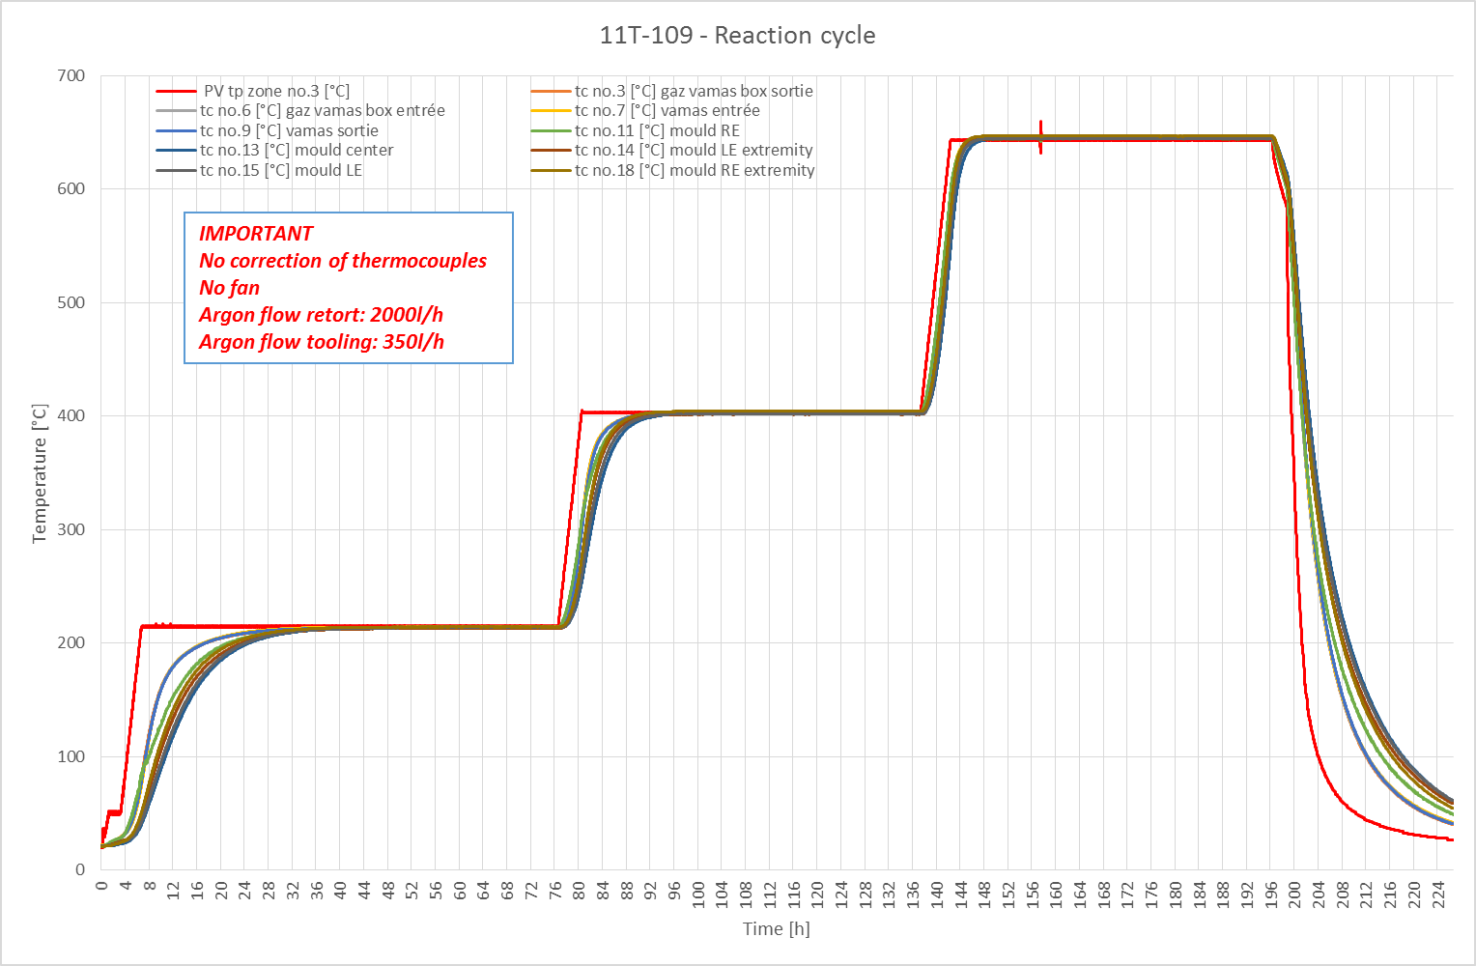
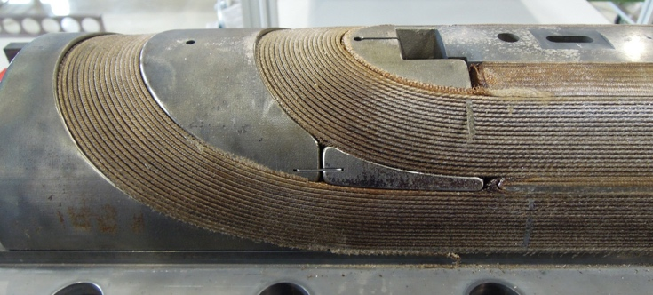
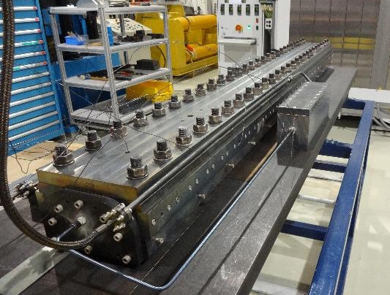
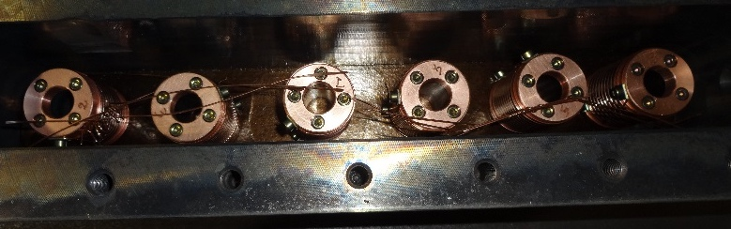
NEW challenges w.r.t. to Nb-Ti magnets, 1
Reaction treatment (48 h @ 210°C – 48 h @ 400°C – 50 h @ 640°C)
To form Nb₃Sn compound

Slide 18
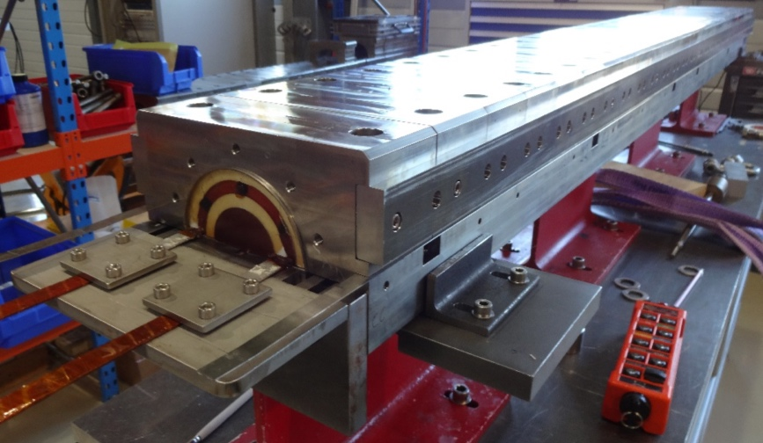
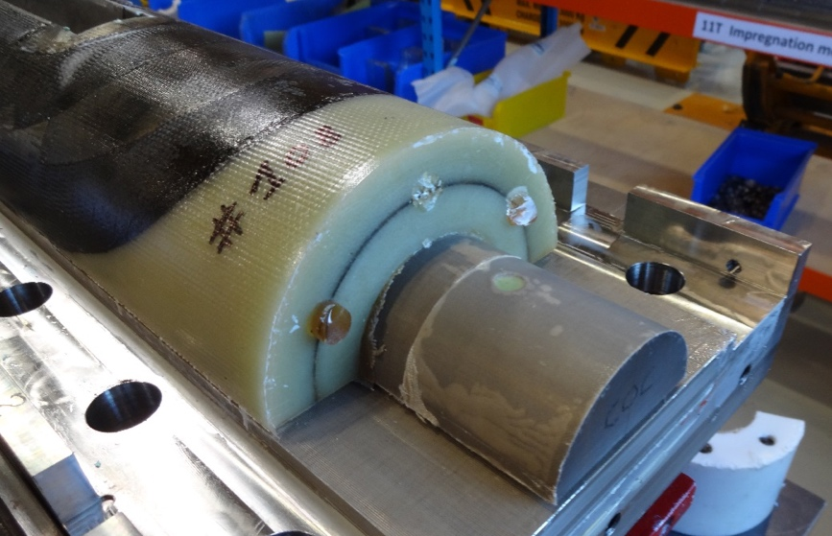
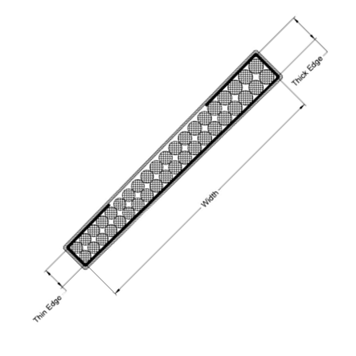
NEW challenges w.r.t. to Nb-Ti magnets, 2
Impregnation
Insulation system:
Mica C-shaped tape
Braided fiber glass impregnated
with epoxy resin

Slide 19
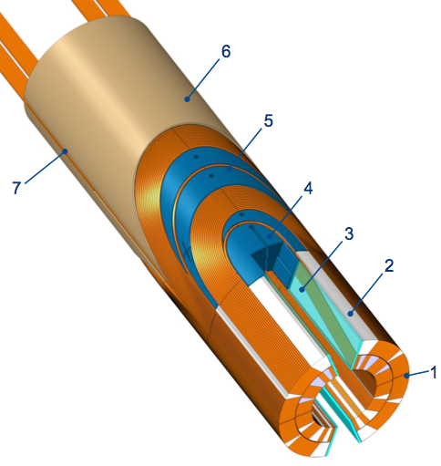
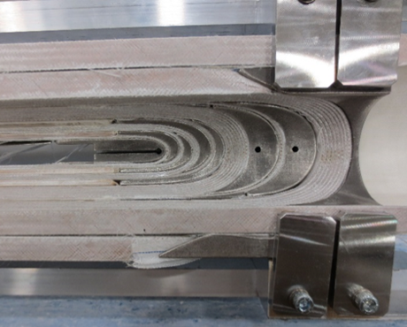
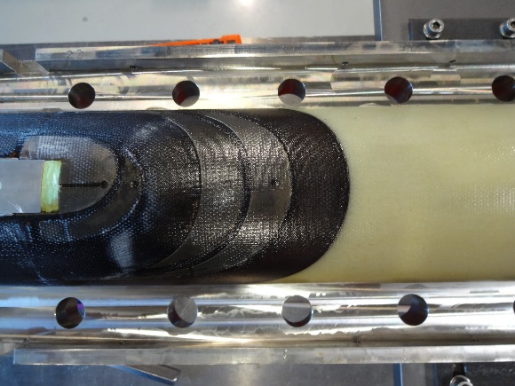

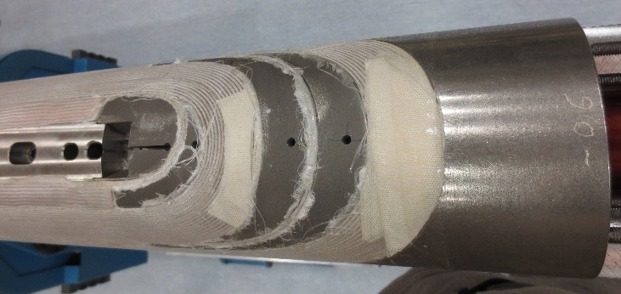
Coil keys – end spacers – saddles
Can be produced from STP files
Item 4: Coil key, AISI 316 L
Item 5: Selective Laser Sintering (SLS) end spacer, AISI 316 L, with flex. legs
Item 6: Saddle, EP-GC22, base material woven glass cloth, matrix epoxy resin
After impregnation
After curing
After reaction

Slide 20
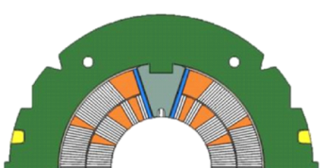
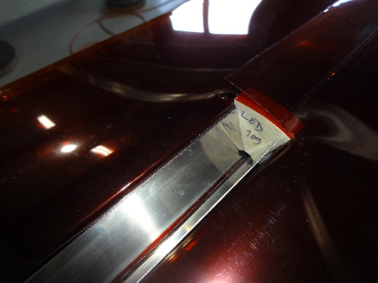
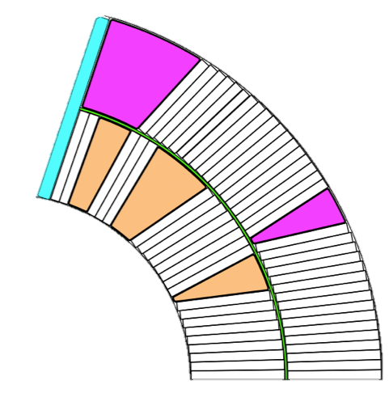
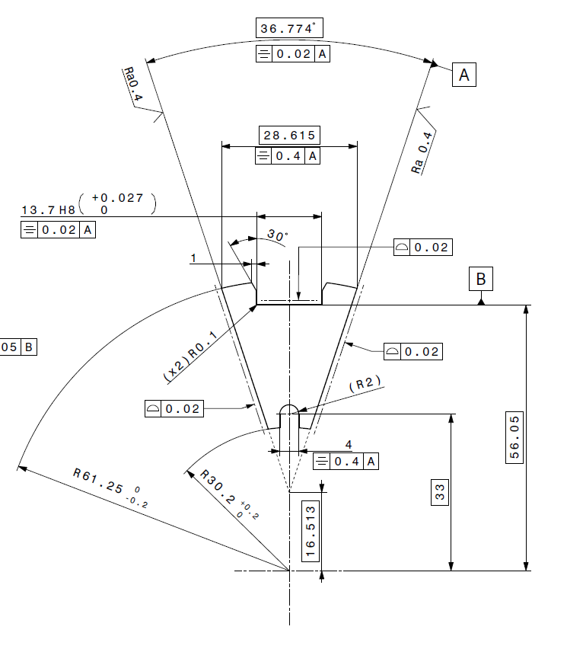
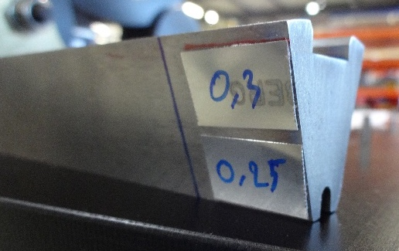
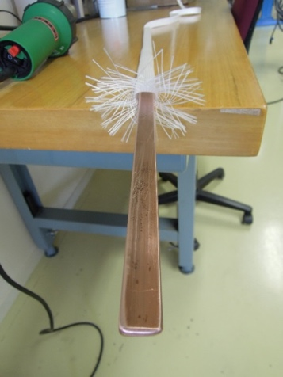
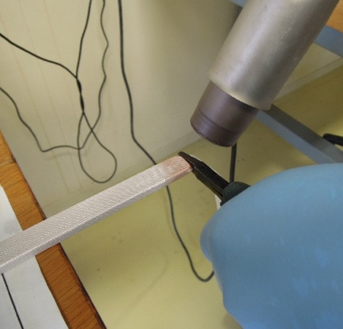
Loading pole – ODS wedge
Loading pole, to be made of titanium,
240 mm long
Wedges, to be made of aluminum Oxide Dispersion Strengthened copper, cold drawn in length of 2.6 m
c
d
Insulated cable
Filler Wedge
Loading plate
Inter-layer
Inner ground wrap
Outer ground wrap
f
b
a
e

Slide 21
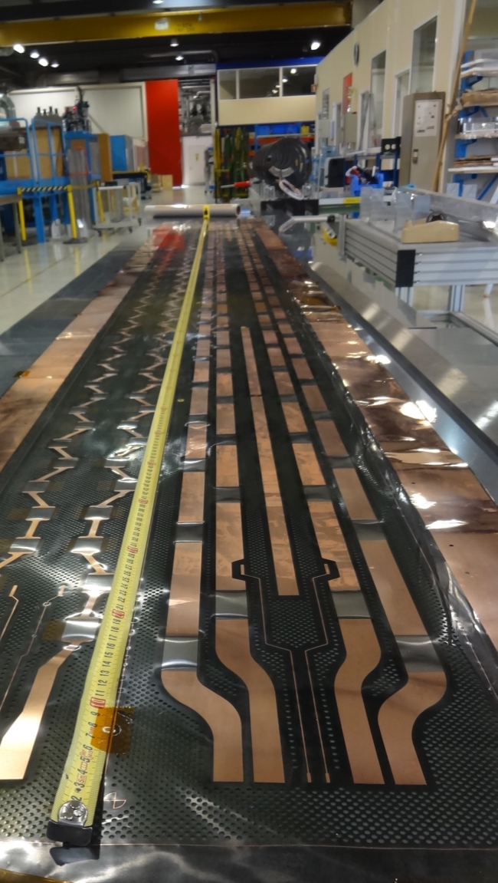
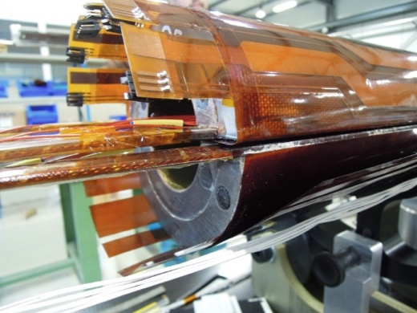
Quench heaters
A strip of stainless steel of 20 μm running along the coil outer
surface
A thin copper layer of 5 μm (electrolytic deposition) to
reduce the resistance of the strip in between 2 heating
areas
The substrate is a 50 μm polyimide film
+
-
+
-
Polyimide film
(substrate)
Non-heating areas
(copper plated stainless steel)
Heating areas
(stainless steel)
Overall length: 5600 mm
Width: 160 to 300 mm

Slide 22
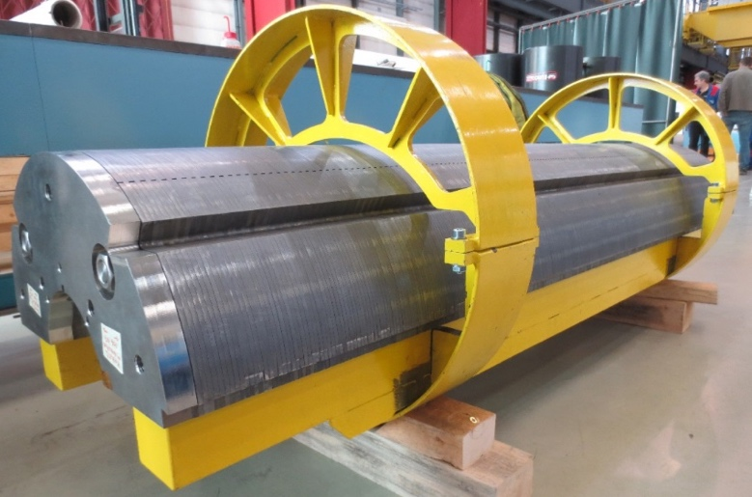
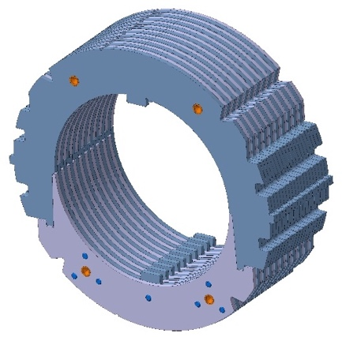
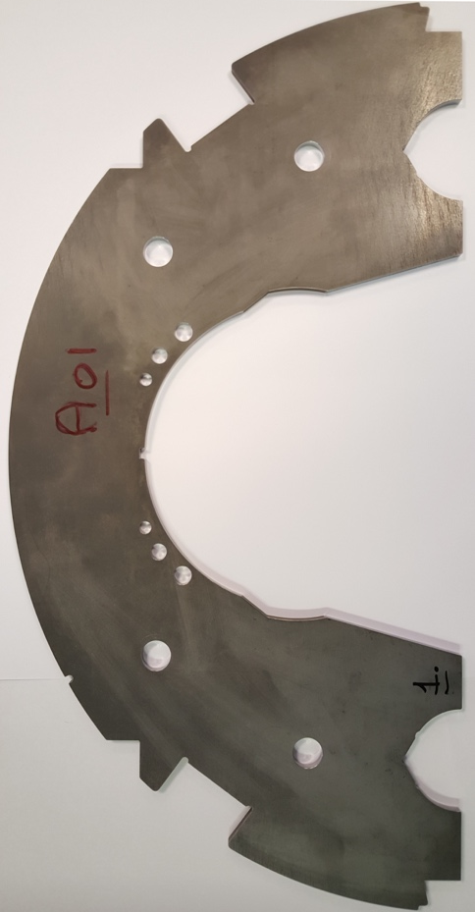
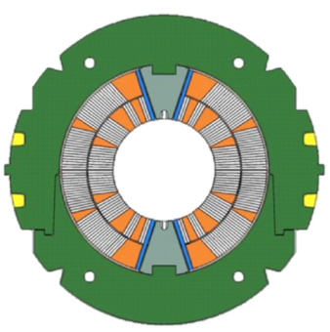
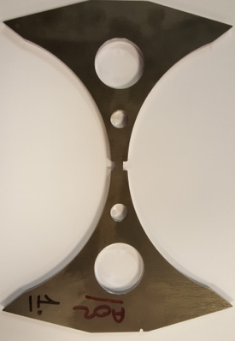
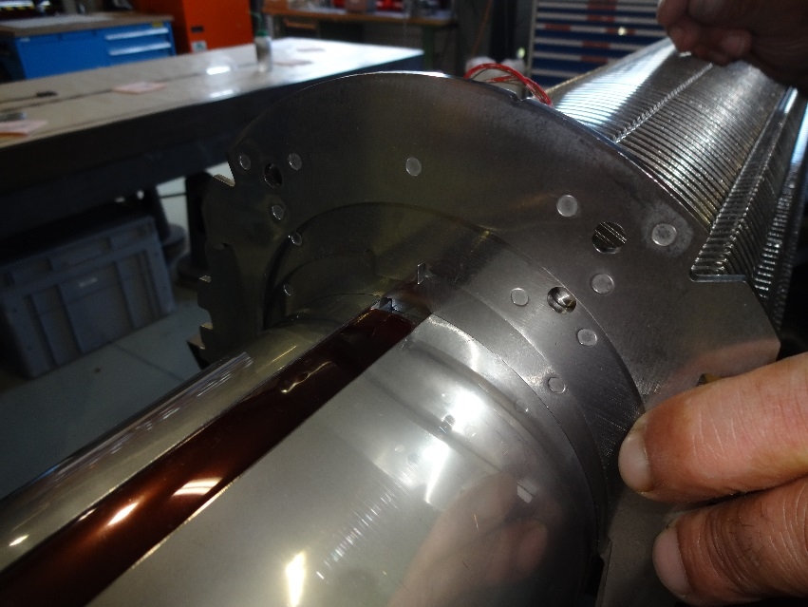
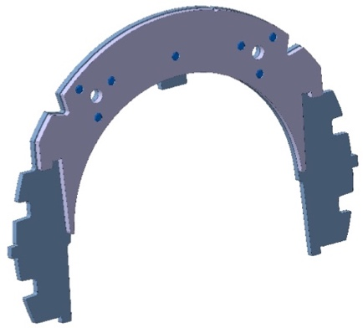
Collars – collaring keys – yoke laminations
Yoke laminations: 5.8 mm thick low carbon steel
Butraco
Jeijen metaaltechniek B.V.
Kusters & Bosch
Collars
    3 mm thick high Mn steel
    σ_{0.2} > 400 MPa

Slide 23
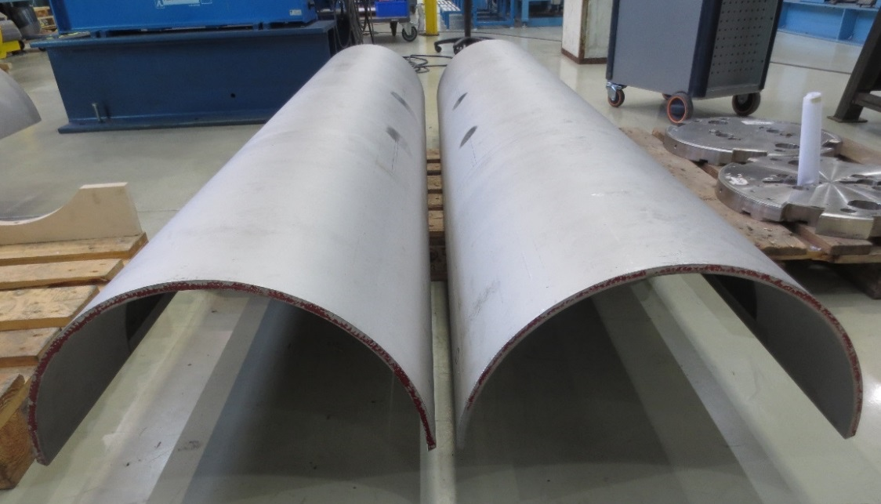
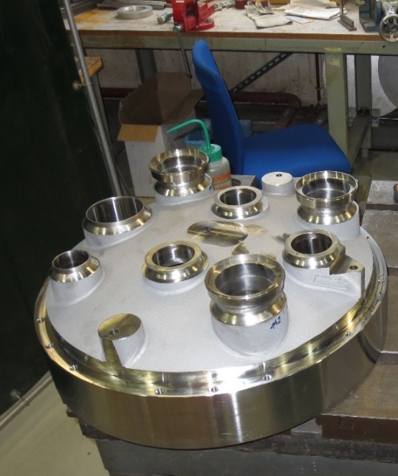
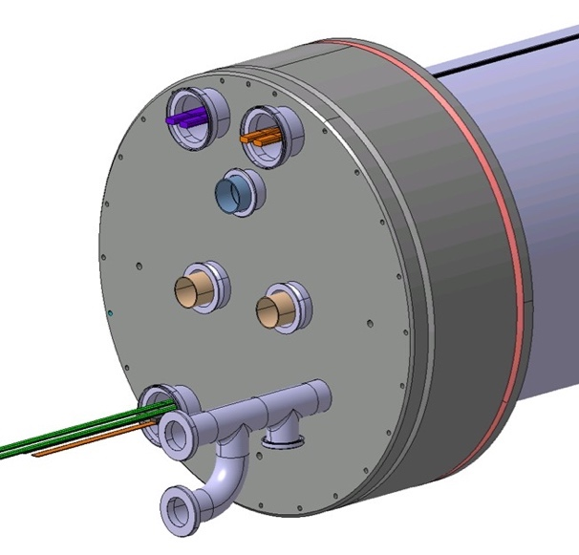
Shells – End covers, main parts of the He vessel
Material: AISI 316 LN, hot rolled plates formed in folding press, thickness: 15 mm
Tight fit with yoke laminations, i.e. need to be precise
Weldability and Leak tightness
Material: AISI 316 LN
Powder metallurgy for the dished cover, or welded construction for the flat cover
Weldability and Leak tightness

Slide 24

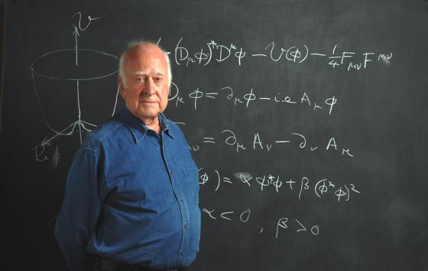
Summary
The HiLumi HL-LHC Project is in the construction phase
Most components are not standard, specifications are demanding
  Materials (remember … will work between -271°C and +640°C for the coil components)
  (Very) tight tolerances
Limited quantities, but high quality requirements
Technology developments are needed,
e.g. magnets, quench heaters
Finding the Higgs boson, and more,
requires exploring the unexplored,
going beyond its own limits
Challenging, however rewarding

Slide 25
Thank you for your attention
For any question, email Frederic.Savary@cern.ch

