Slide 1
Knowledge Transfer at CERN
David Mazur
IP Dissemination Section Leader
Knowledge Transfer Group
CERN

Slide 2
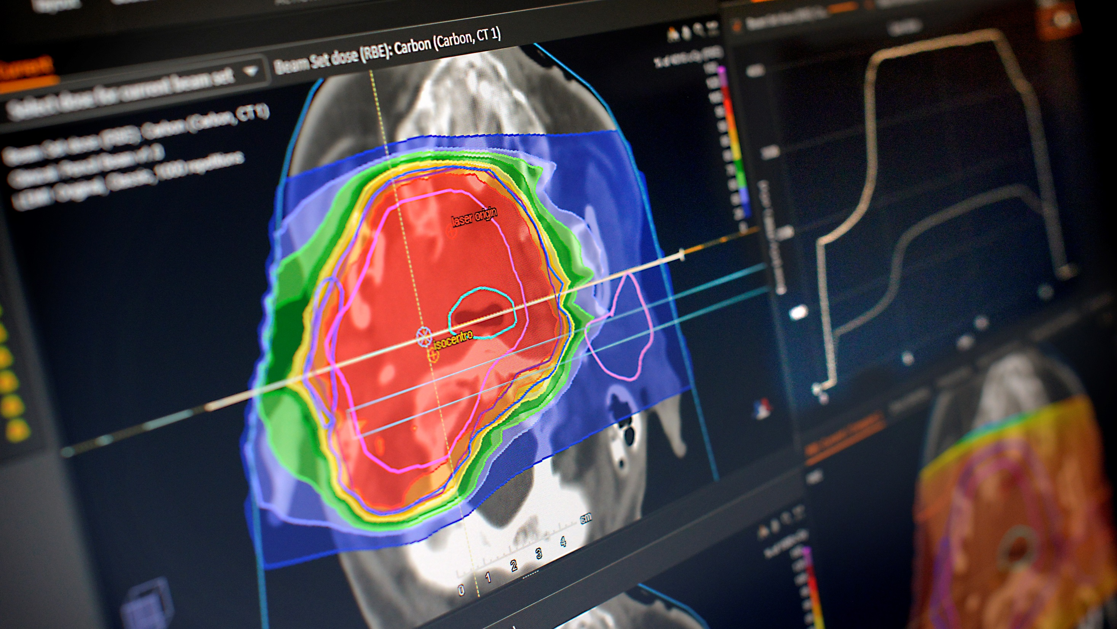
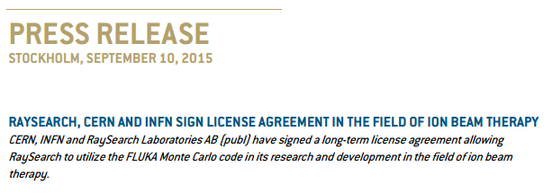
How to make therapy less harmful to patients ?
http://www.raysearchlabs.com/about/press/?year=2015&cisionid=1977472

Slide 3
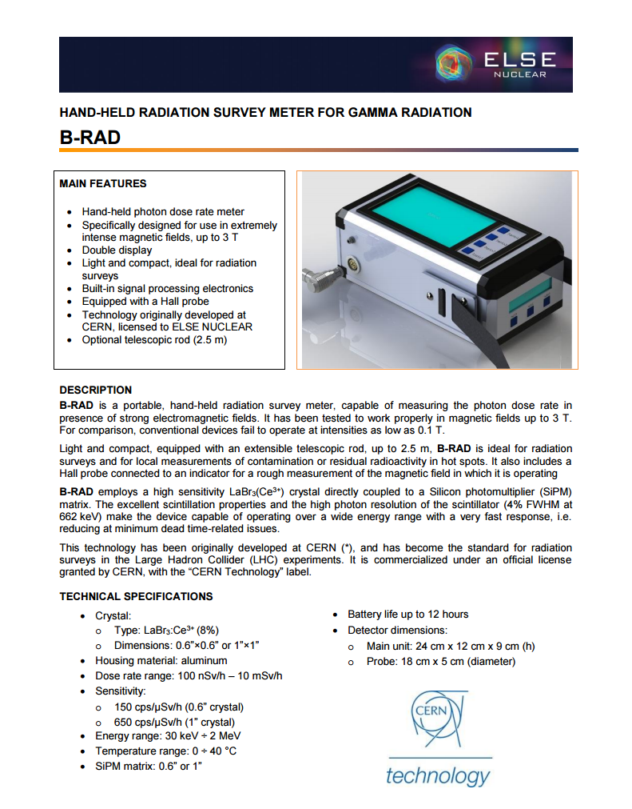
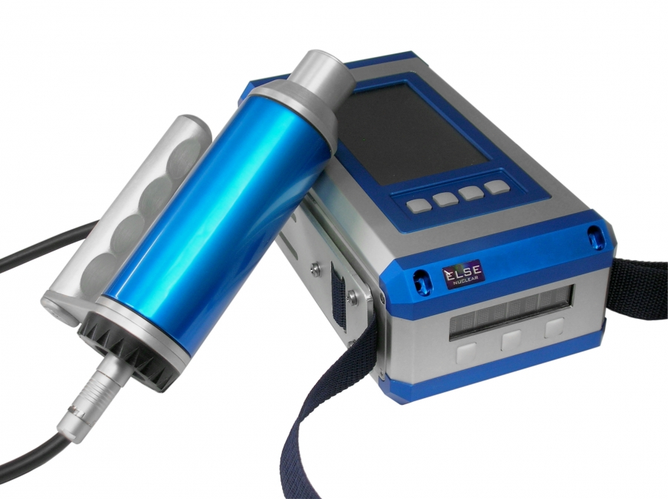
How to increase the safety in unknown hazardous environments ?
http://www.elsenuclear.com/en/b-rad

Slide 4
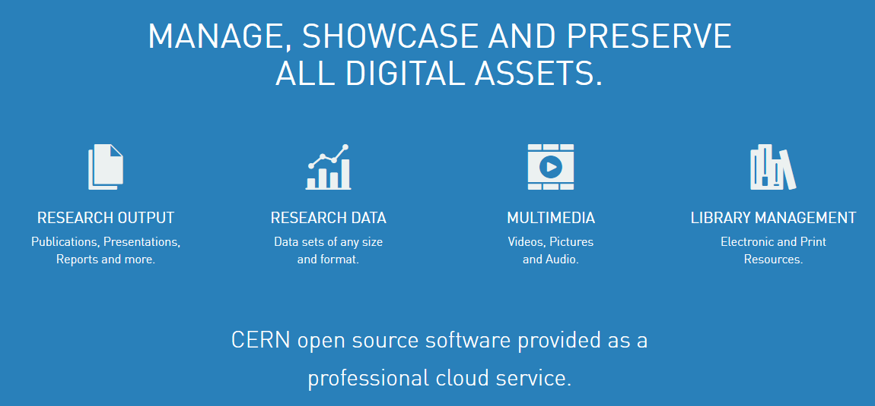
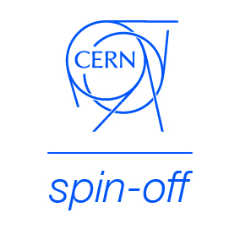
How to help organizations manage information… and disrupt the market
http://tind.io

Slide 5
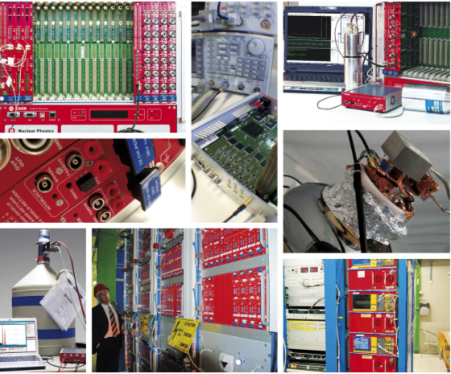
How to make scientific instrumentation more performing ?
“ The unit features High Performance Time to Digital Converter chips developed by CERN.”
http://www.caen.it/csite/CaenProd.jsp?idmod=789&parent=11

Slide 6
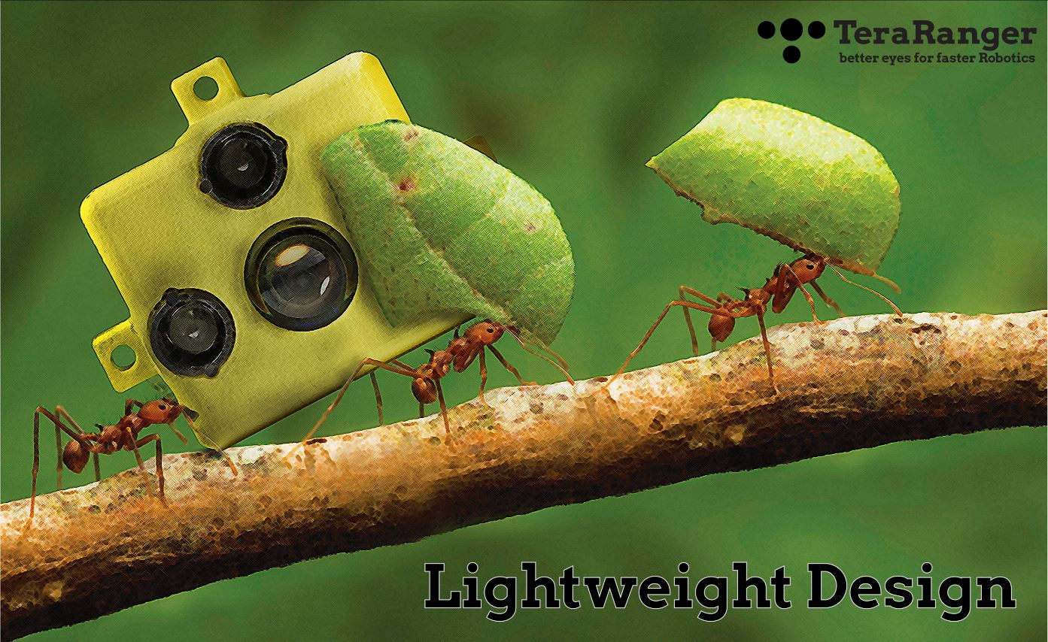
How to avoid human exposure to hazardous environments ?
http://www.terabee.com/

Slide 7
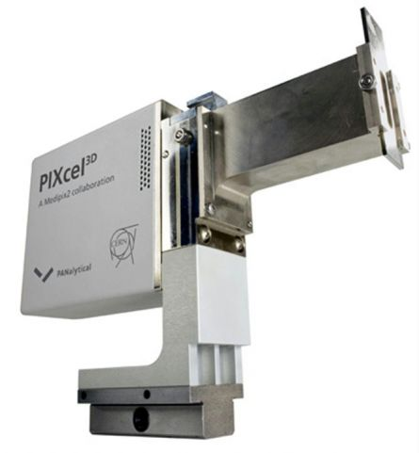
How to make material analysis more performing ?

Slide 8
How to improve monitoring of water quality ?
http://www.camstech.co.uk/

Slide 9
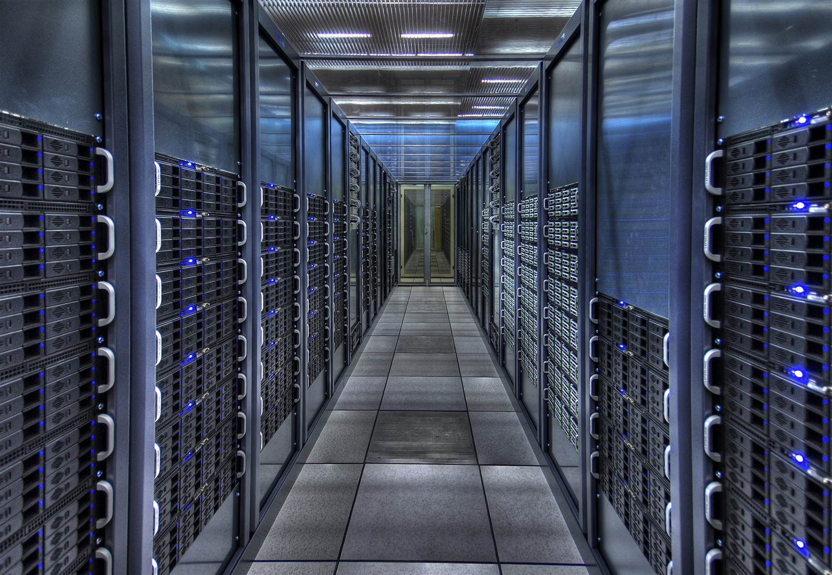
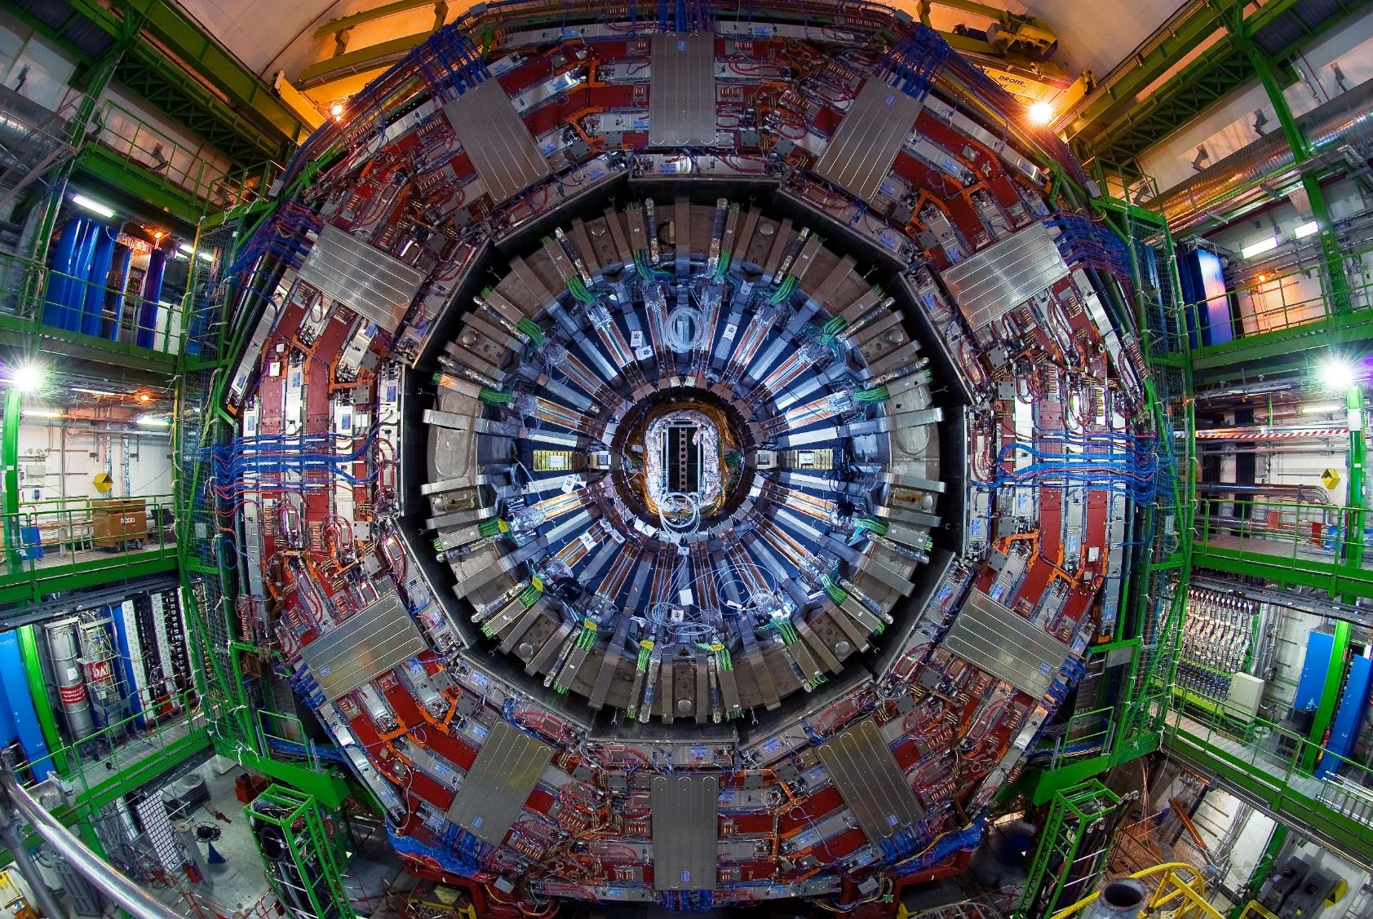
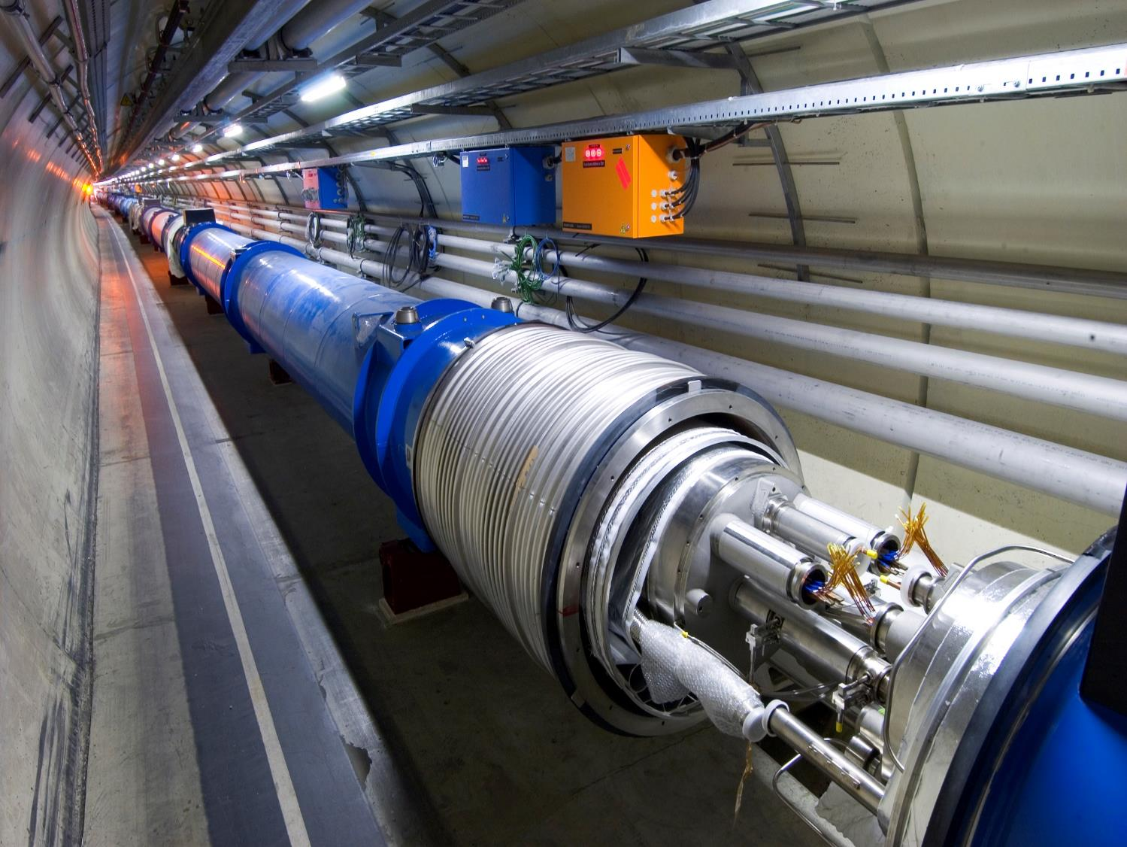
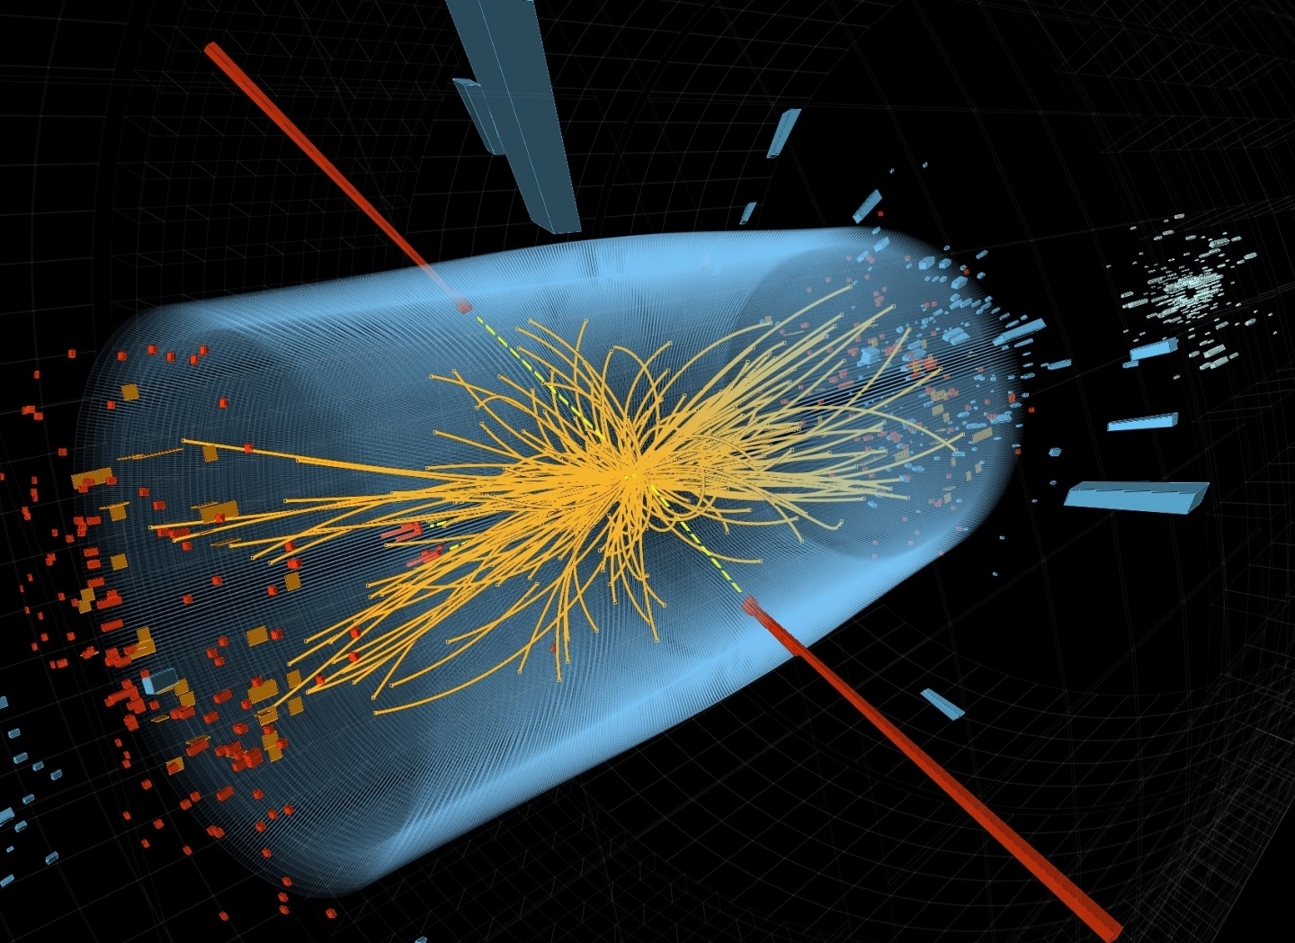
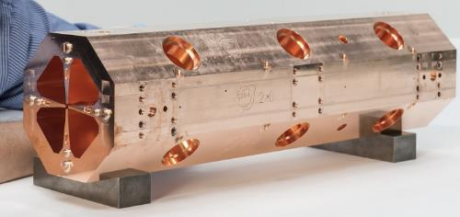
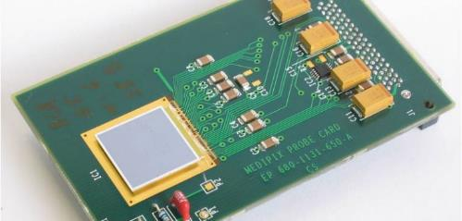
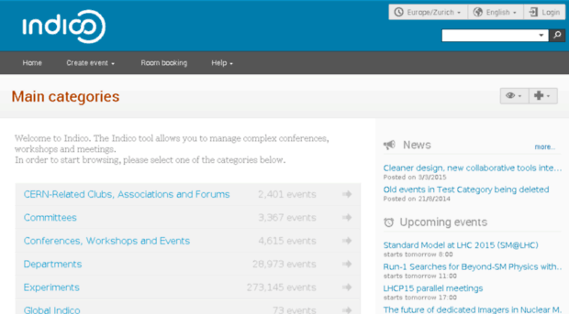
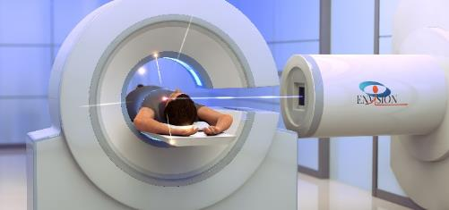
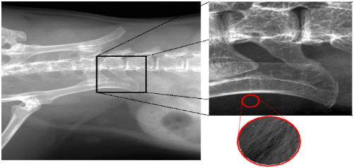
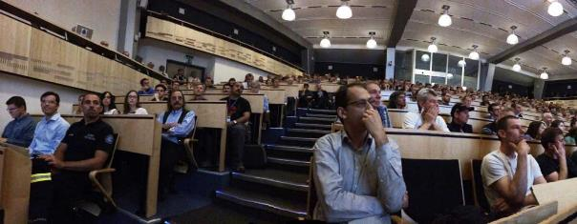
Accelerators
Detectors
Computing

Slide 10
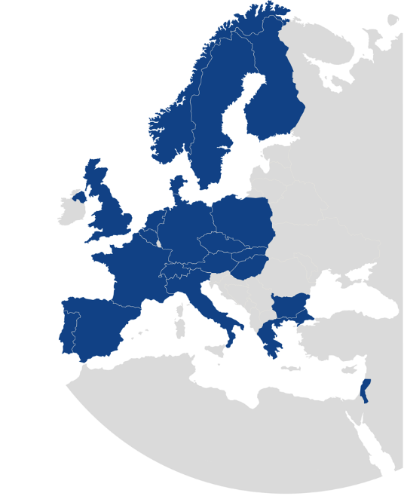
KT Mission
Maximize the technological and knowledge return to Society, specially in the Member States
Promote CERN’s image as a center of excellence for technology
Key words: dissemination and impact!

Slide 11
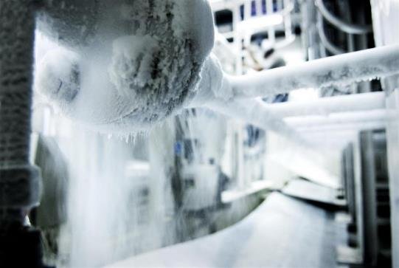
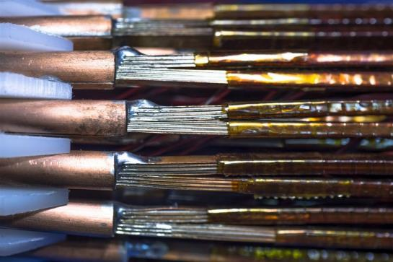
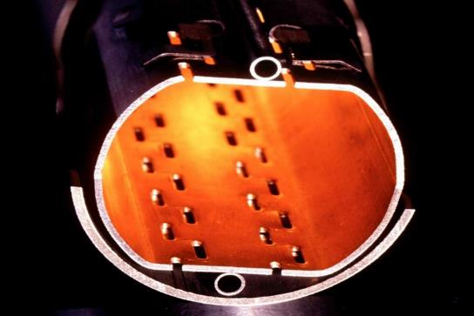
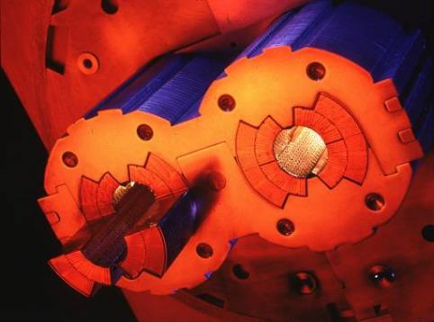
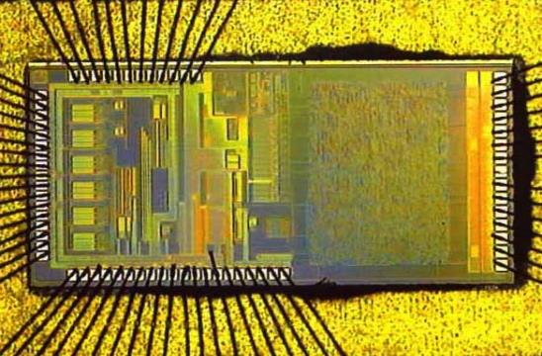
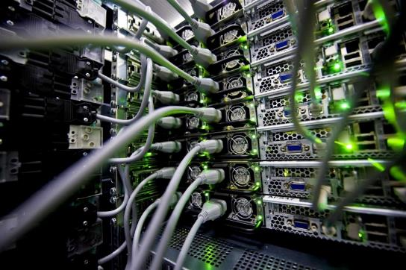
CERN Core Competences
Cryogenics
Superconductivity
Vacuum
Magnets
Microelectronics
Data Processing

Slide 12
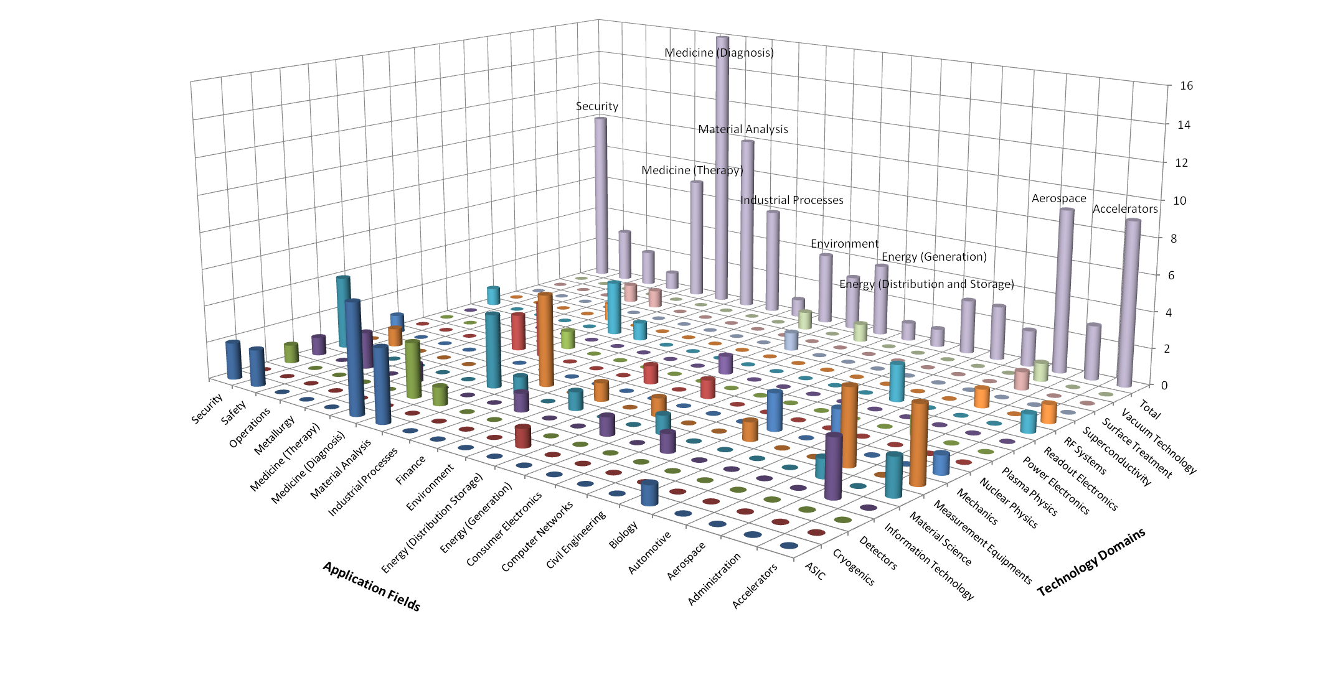
CERN’s Technology Portfolio

Slide 13
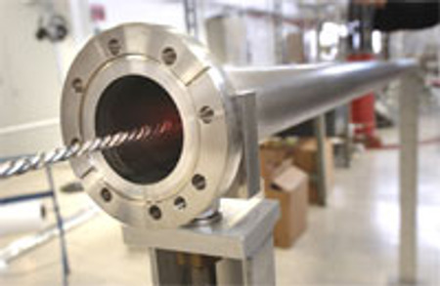
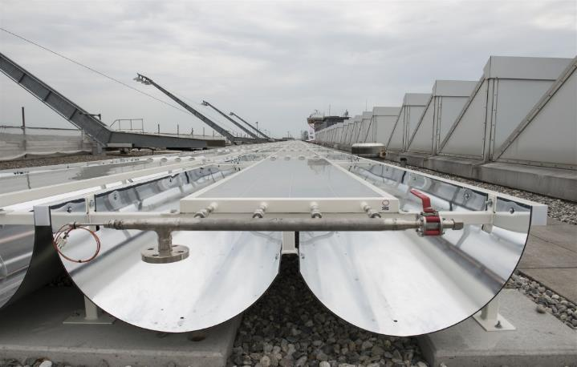
From high vacuum… to solar energy
CERN Technology
Non-Evaporable Getter Coating
Industry (spin-off):
High Efficiency Solar Collectors

Slide 14
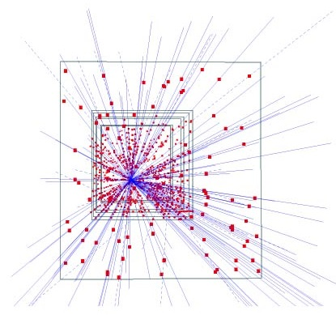
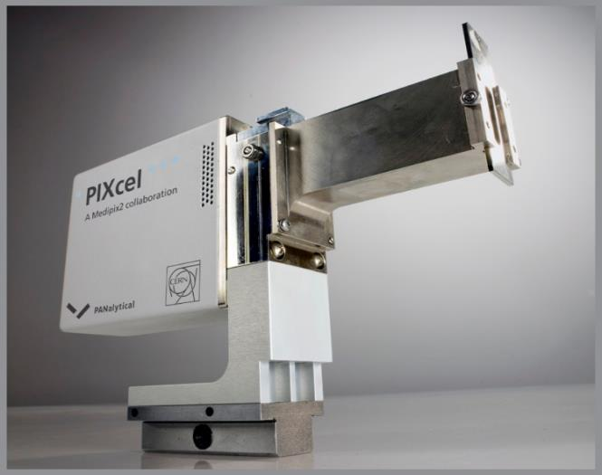
From silicon pixel detectors to X-Ray diffractometers
CERN Technology
Hybrid silicon pixel detector
Industry (license):
X-Ray Diffractometer

Slide 15
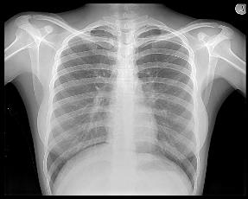
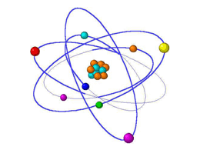
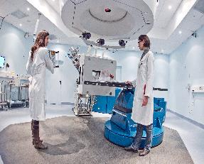
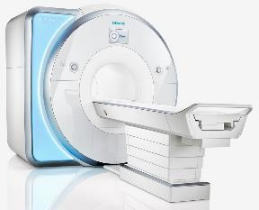
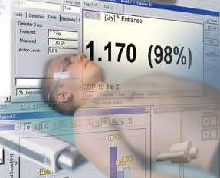
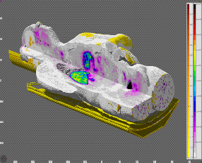
Medical Applications at CERN
“Medical Applications (MA) have been, are and will be a primary component of CERN’s knowledge transfer activities. The (new) directorate is firmly committed to this goal.”
F. Gianotti, CERN Director-General
Imaging | Radioisotopes | Hadron Therapy
MRI | Dosimetry | Planning & Simulation

Slide 16
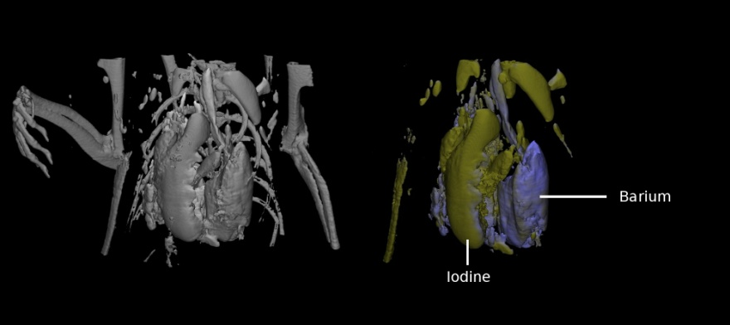
KT Projects for Medical Applications - Medipix

Slide 17
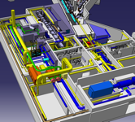
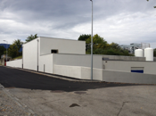
KT Projects for Medical Applications - Medicis

Slide 18
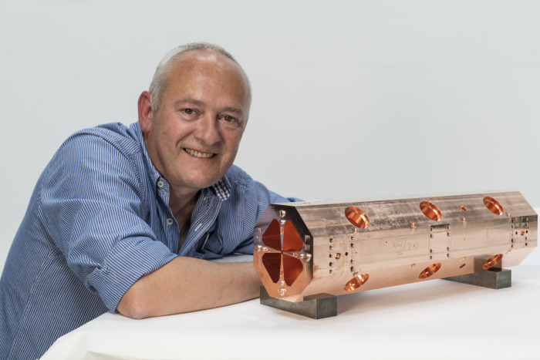
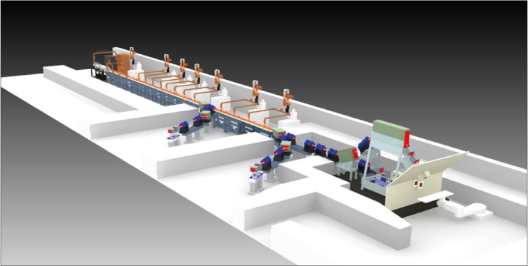
KT Projects for Medical Applications – Compact RFQ

Slide 19
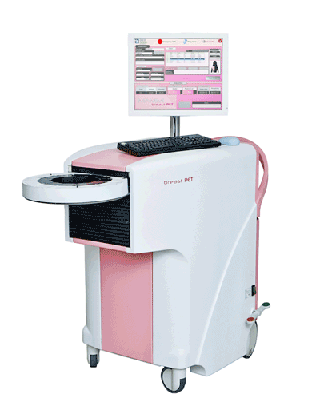
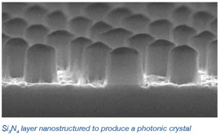
KT Projects for Medical Applications – Photonic Crystals

Slide 20
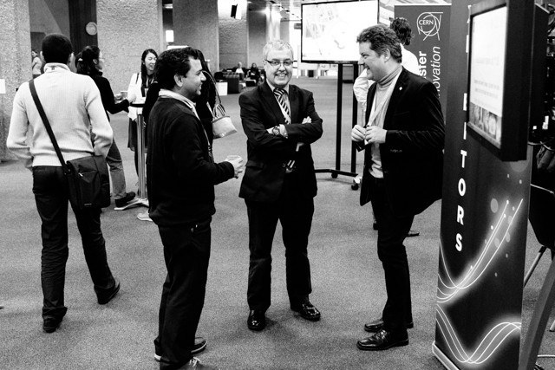
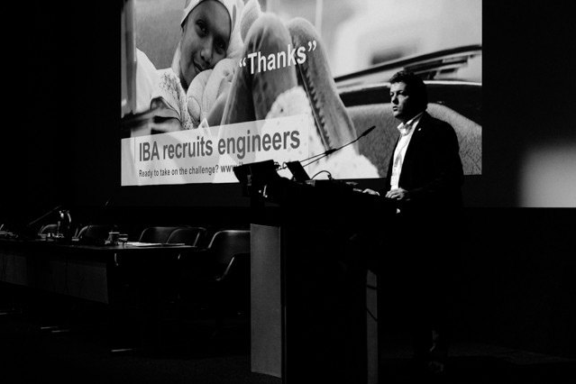
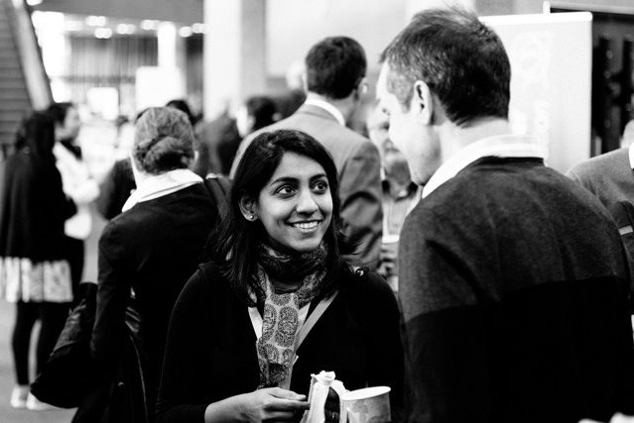
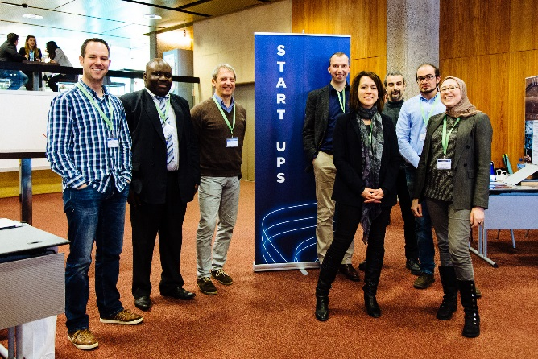
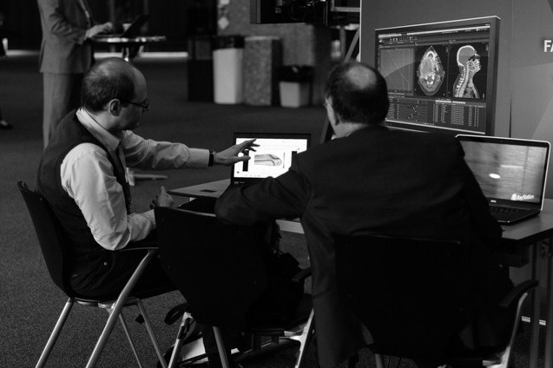
Bringing medical physics and medical industry together

Slide 21
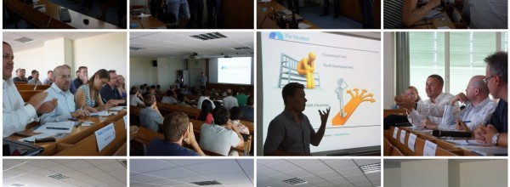
Entrepreneurship Development
Fostering an Entrepreneurship Culture
Facilitating CERN Spin-Off creation

Slide 22
CERN BIC Network
Established incubators:
UK – STFC-CERN BIC
Netherlands – NIKHEF-CERN BIC
Norway – NTNU BIC of CERN Technology
Greece – Technopolis BIC of CERN Technology
Austria – Austria BIC of CERN Technology
France – InnoGEX BIC of CERN Technology
Finland – Finnish BIC of CERN Technology
Spain – Spanish BIC of CERN Technology
Advanced Pipeline:
Italy

Slide 24
Langton Ultimate Cosmic ray Intensity Detector uses 5 Timepix chips to monitor the radiation environment in Space
CERN@school allows students to use a Timepix chip in the lab to visualise radiation
Data from LUCID and CERN@school detectors will be uploaded to the Grid and made available for students to analyse

Slide 25
Open Source Software
Originating from CERN | Contributed to by CERN
And many more

Slide 26
Open Source Hardware and CERN Open Hardware Licence (OHL)
A legal framework to facilitate knowledge exchange across the electronic design community.
Governs the use, copying, modification and distribution of hardware design documentation, and the manufacture and distribution of products.
www.ohwr.org

Slide 27
CERN OHL: it is making an impact!

Slide 28
Knowledge Transfer through People
Every year, hundreds of students come to CERN to contribute to our research programs
An opportunity for young people to learn in a multicultural environment
Not only for physicists! Also engineers, computer scientists, administrative students…

Slide 29
KT Annual Report 2015

Slide 30
Visit our website to have a look at our technology portfolio in detail
cern.ch/kt

Slide 31
CERN Knowledge Transfer Group
cern.ch/kt
Mail-KT@cern.ch
David.Mazur@cern.ch
Tel. +41 22 767 2623

