Slide 1
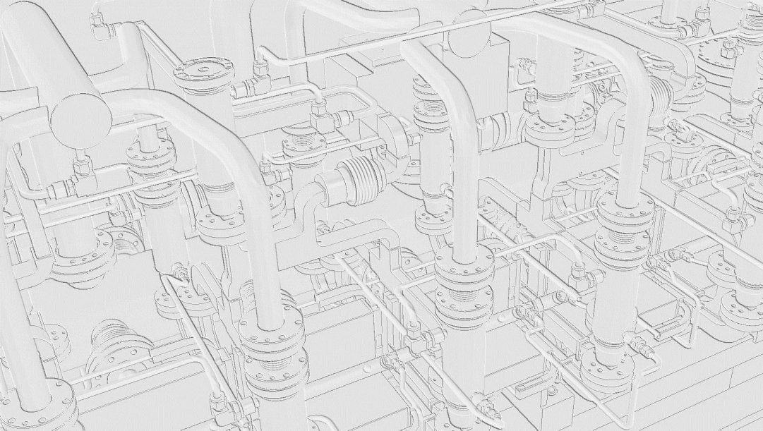
CLIC Module
and
X-band RF components
Alexandre.Samochkine @ cern.ch

Slide 2
CONTENT
CLIC LAYOUT
CLIC MODULE
  - LAB version
  - CLEX version
RF COMPONENTS
  - Accelerating Structure
  - Power Extraction and Transfer Structure
  - PETS “On-Off” mechanism
  - Choke Mode Flange
  - Hybrid
  - Splitter
  - RF Compact Load
  - 60 db Directional Coupler
  - Compact RF Pumping Port
  - RF Vacuum Gate Valve

Slide 3
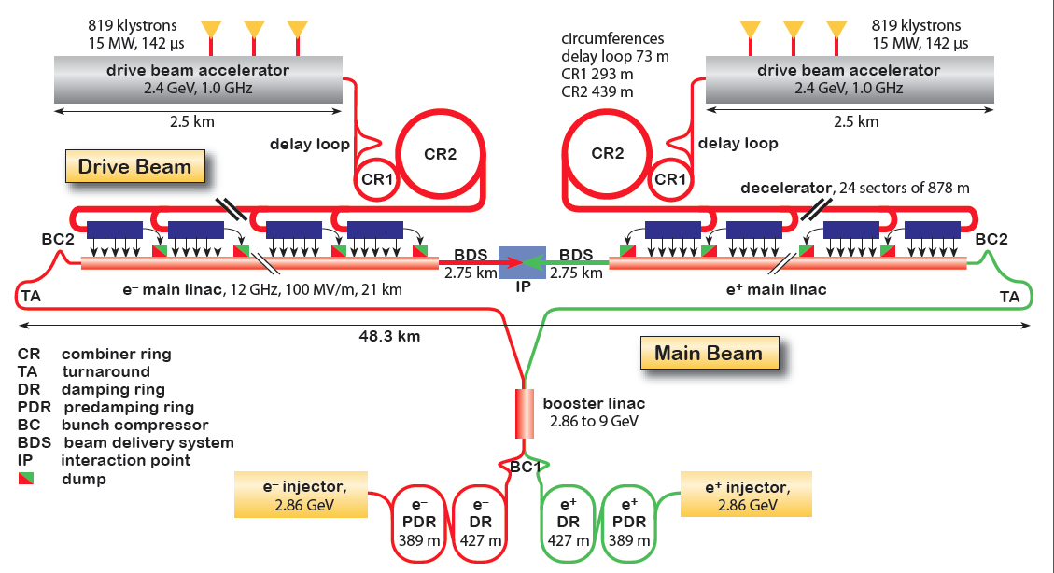
OVERALL CLIC LAYOUT ( 3 TeV )
Drive Beam Generation Complex
Main Beam Generation Complex
Main LINAC
x 2 = 21452 Two-Beam Modules

Slide 4
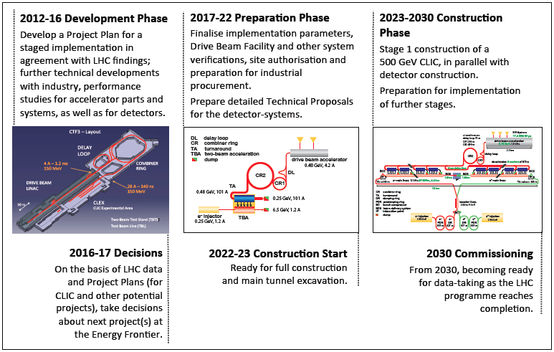
CLIC project time-line *
* S. Stapnes, CLIC Workshop 2013, CERN

Slide 5
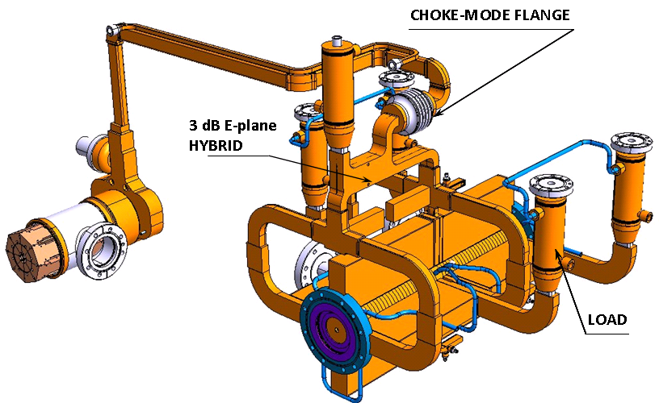
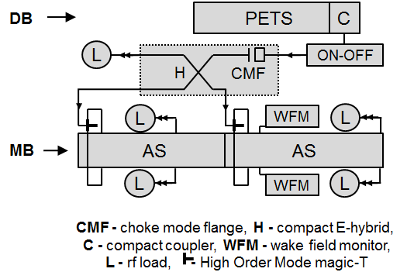
RF UNIT
*
P ower
E xtraction &
T ransfer
S tructure
Each PETS * feeds 2 AS **
**
A ccelerating
S tructure
3D model
Schematic view

Slide 6
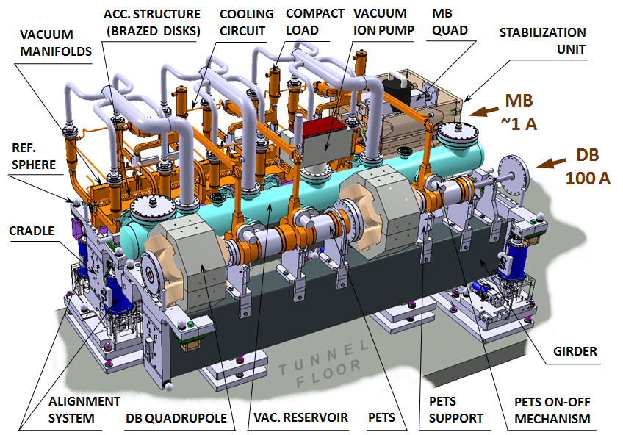
CLIC MODULE LAYOUT
n RF units + magnets + vac. syst. + alignment syst. + stabilization syst. form the Module (L = 2010 mm)
CLIC at 500 GeV → 26’950 Accelerating Structures, 13’475 PETS, ~ 80’000 RF components
CLIC at 3 TeV → 143’072 Accelerating Structures, 71’536 PETS, ~ 400’000 RF components

Slide 7
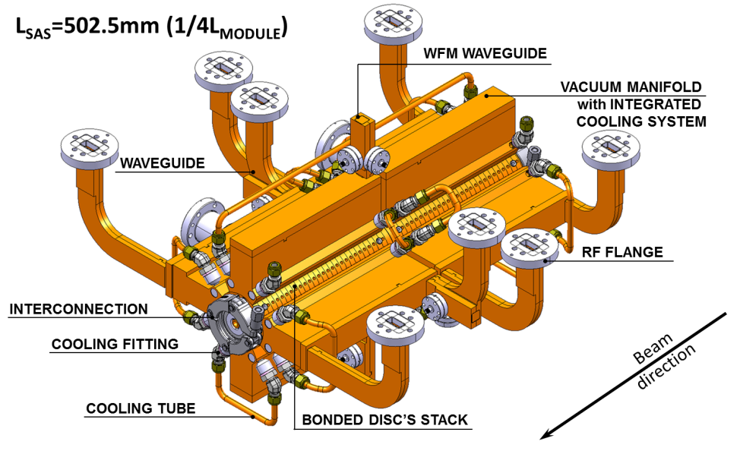
ACCELERATING STRUCTURE
… is the most complex and precise component

Slide 8
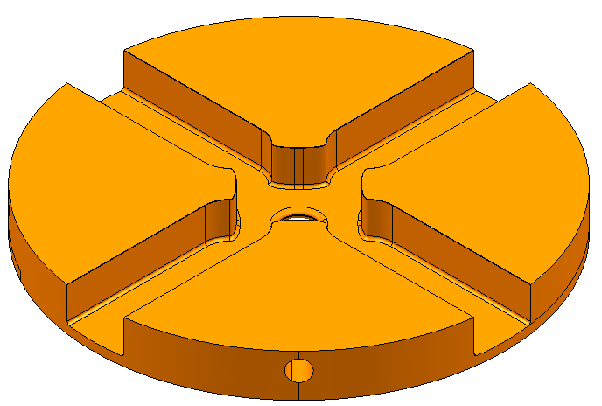
AS CELL
… the tolerances required to satisfy the RF and beam dynamic constraints
ZONE B
ZONE A
regular cell
Cell shape accuracy:
  zone A - 0.005 mm
  zone B - 0.02 mm
Flatness - 0.001 mm
Surface roughness:
  zone A Ra 0.025 μm
  zone B Ra 0.1 μm
DRAWING

Slide 9
Super AS assembly
a number of bonding and brazing cycles needed

Slide 10
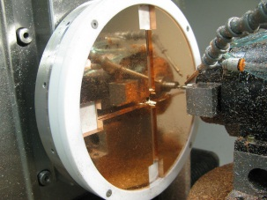
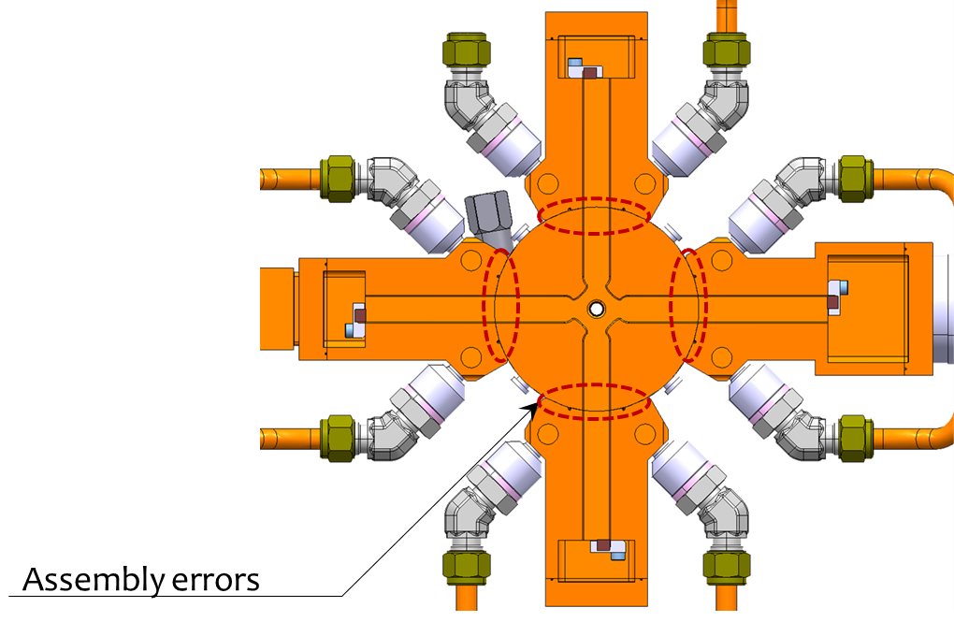
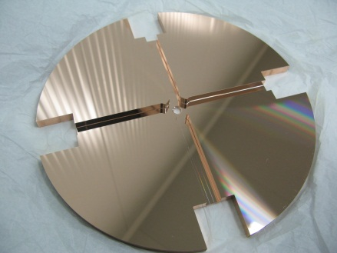
Vacuum manifolds are brazed to the bonded disk stack
- many pieces to handle;
- potential assembly errors;
- risk of braze filler material inside the structure;
- additional features (e.g. cooling circuits).
Several heating cycles;
High cost.
First prototype: under test at CERN
Machining test;
Bonding test.
Second prototype: under engineering design
Optimised geometry (less material);
Bonding test.
Launched the study of integrated disk (➔integrate several function as one piece).

Slide 11
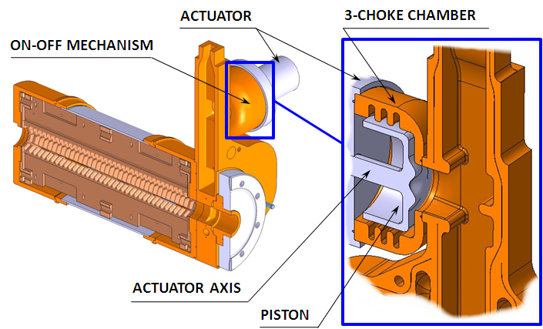
PETS
… made of joint octants placed in a mini-tank brazed to a compact coupler combined with ‘ON-OFF’ mechanism
P ower
E xtraction &
T ransfer
S tructure

Slide 12
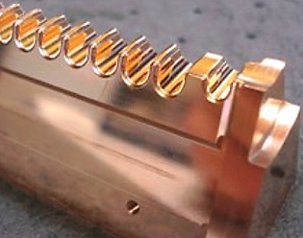
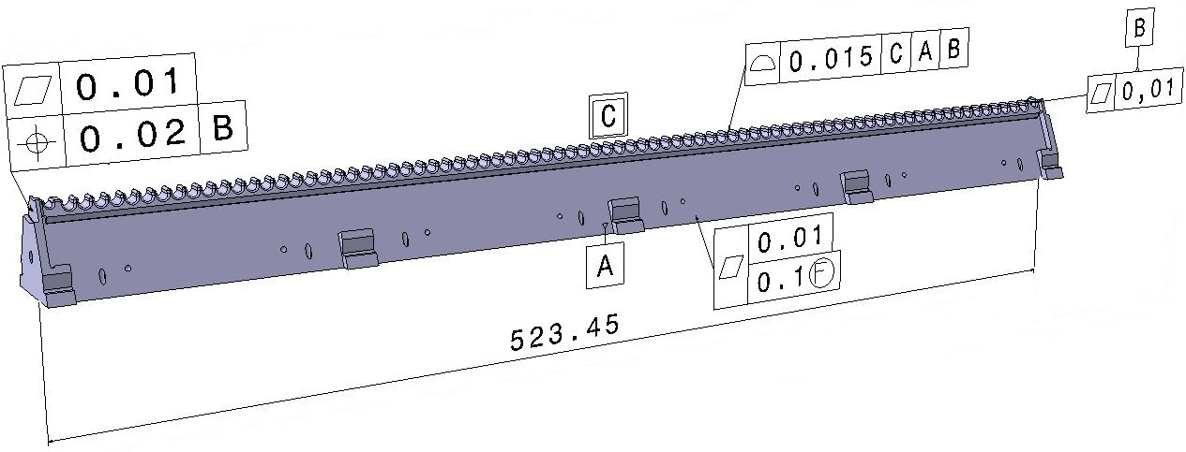
PETS bar (octant)
Octant shape accuracy - 0.015 mm
Flatness - 0.01 mm
Surface roughness - Ra 0.1 μm
Double-length PETS bar for CLEX tests
DRAWING

Slide 13
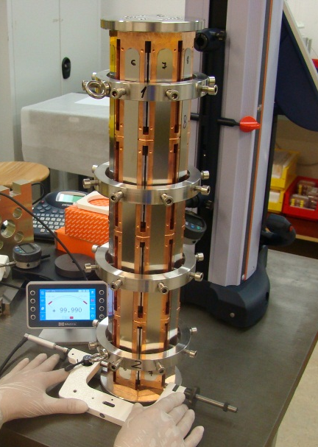
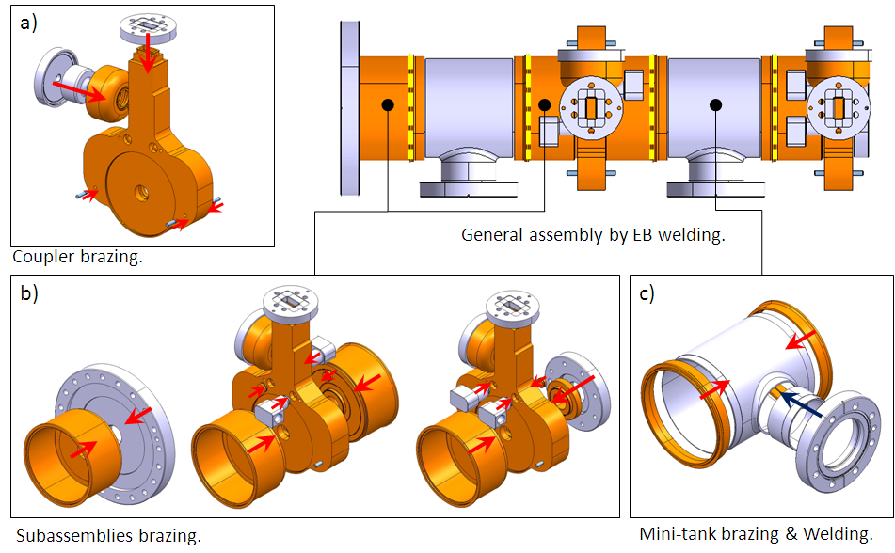
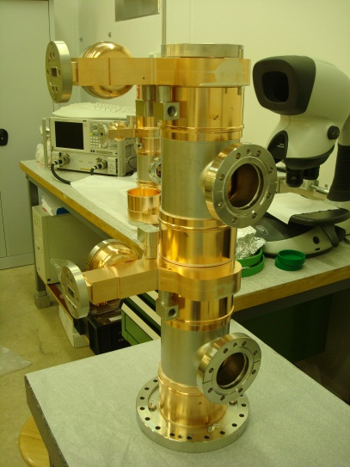
PETS UNIT ASSEMBLY
Pre-alignment
& control
brazing and EBW steps required
Assembled unit

Slide 14
MODULE PROTOTYPE TEST PROGRAM
2010 - 2017
NEEDS 2013-2017
2013
20 AS, 10 PETS
2014
24 AS, 12 PETS
2015
32 AS, 16 PETS
2016
32 AS, 16 PETS
2017
32 AS, 16 PETS
LAB version (no RF) → 4 modules
Demonstration of the two-beam module design (from single technical system to complete modules)
This implies the assembly and integration of all components and technical systems, such as RF, magnet, vacuum, alignment and stabilization, in the very compact 2-m long two-beam module
CLEX version (beam, RF) 3 modules
Demonstration of the two-beam acceleration with beam and RF with real modules
Address other feasibility issues in an integrated approach

Slide 15
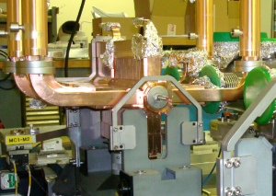
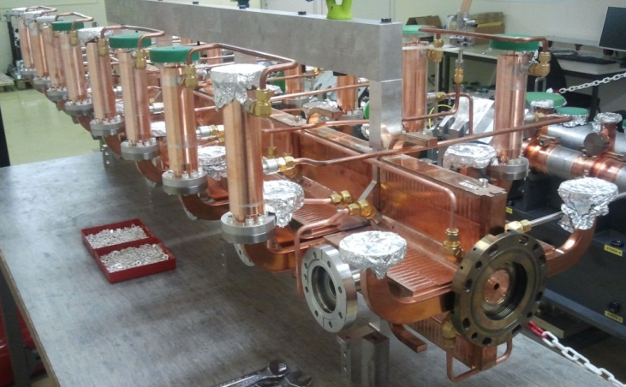
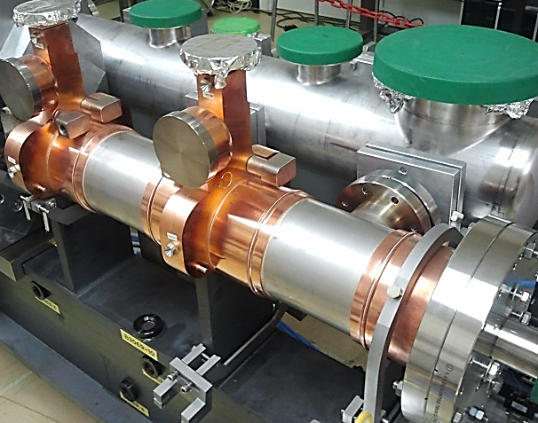
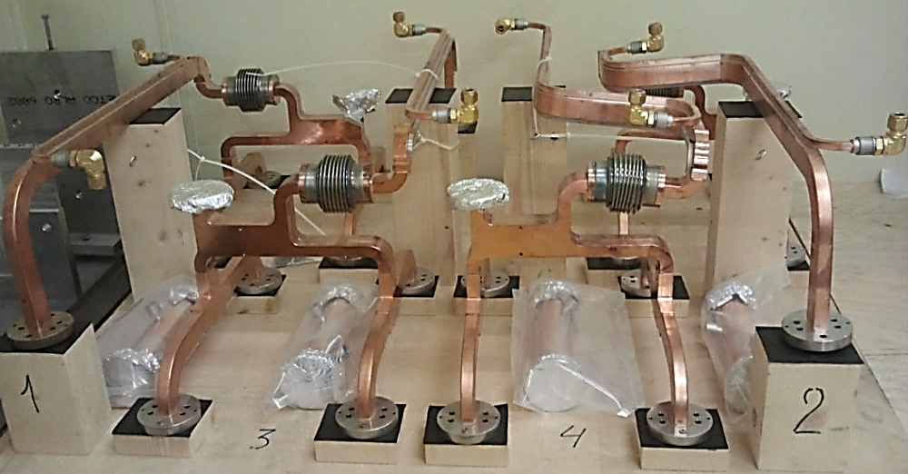
PREPARATION AND MODULE ASSEMBLY ( LAB )
First fitting of the first Super-AS
8 AS ready for installation
PETS fixed on the Drive Beam girder
RF network

Slide 16
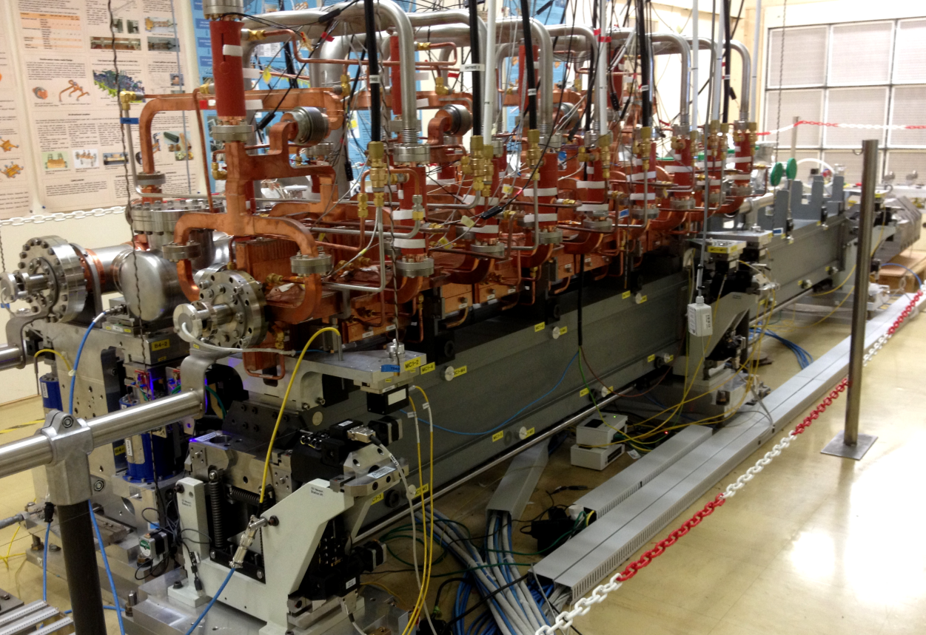
LAB TESTS
the first LAB Module (assembled at the end of 2012) is currently under thermal tests

Slide 17
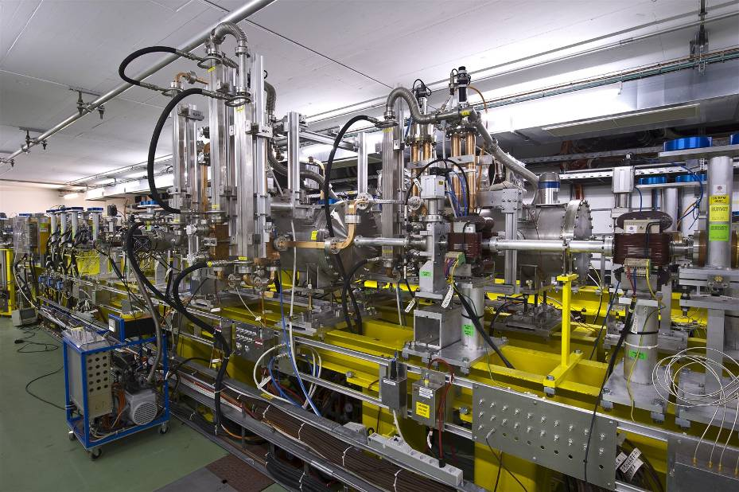

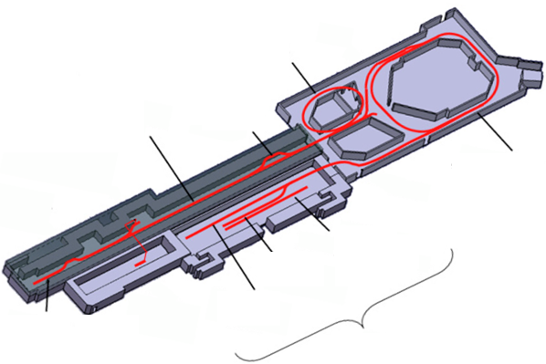
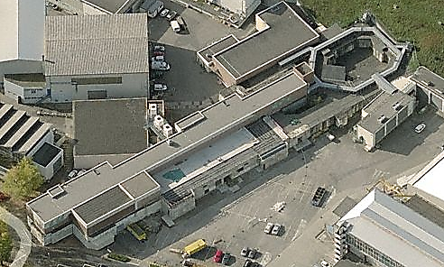
CTF3 (CLEX)
CLEX -
CLIC EXperimetal area
PETS tank
T wo
B eam
T est
S tand
AS tank
C LIC
T est
F acility
DELAY LOOP
CHICANE
LINAC
COMBINER RING
CALIFES
Probe Beam
Injector
TBTS
TWO-BEAM
LINE
INJECTOR
CLEX

Slide 18
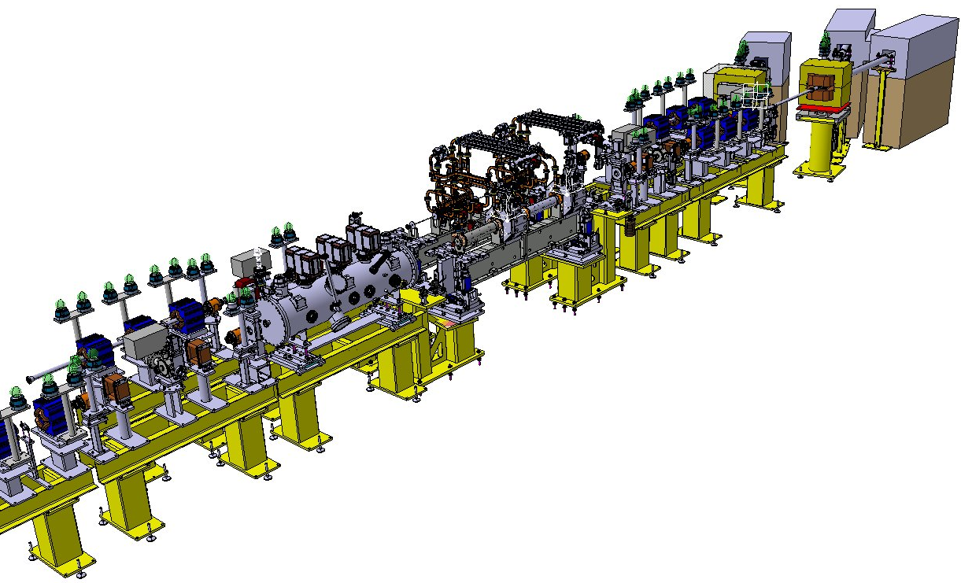
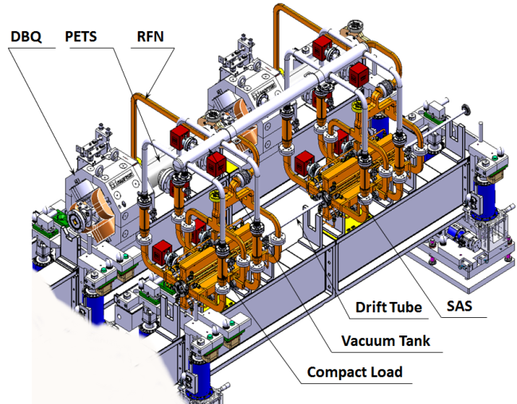
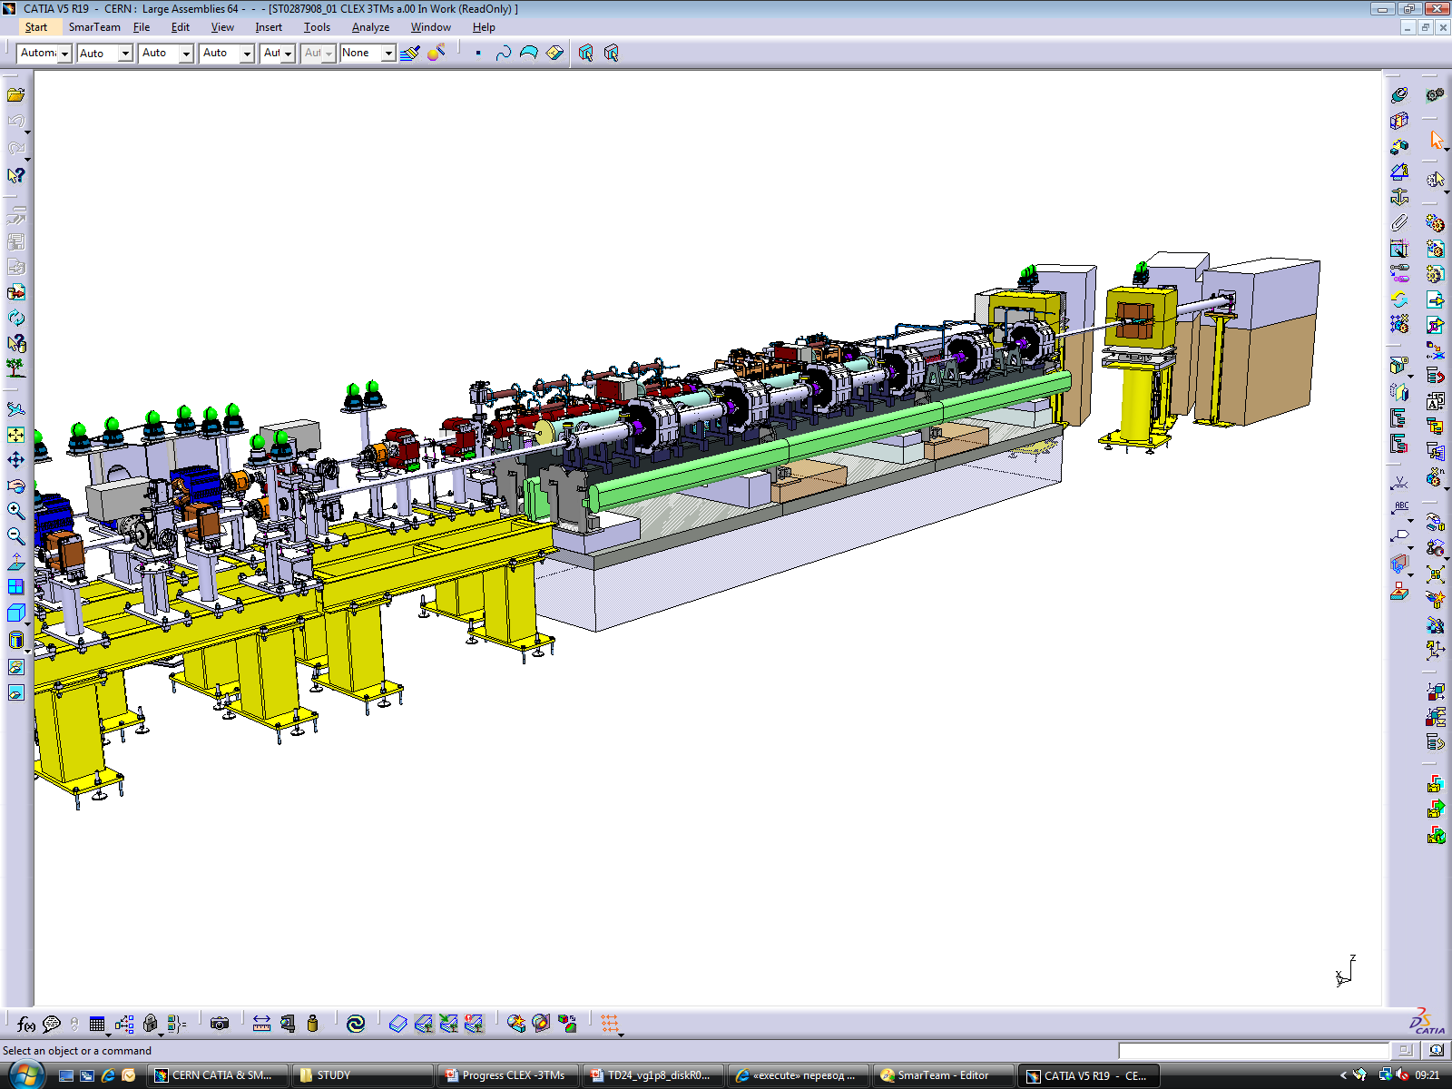
PROTOTYPE MODULES IN CLEX
end 2013
CLEX -
CLIC EXperimetal area
CLEX Module Type 0
3D model. Integration of
the first CLIC Module in CLEX (Jun’13)
2014 –
– 2017
3 modules

Slide 19
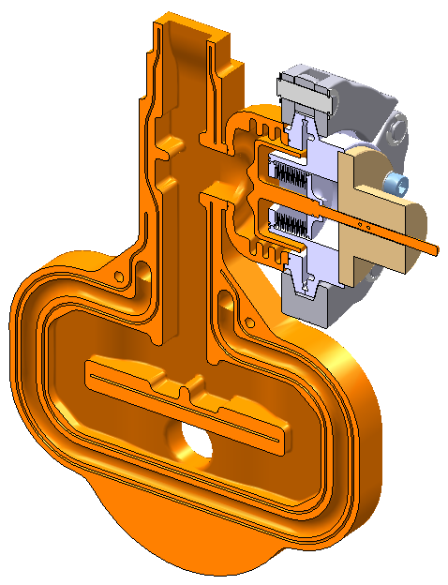
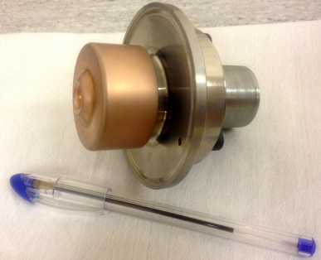
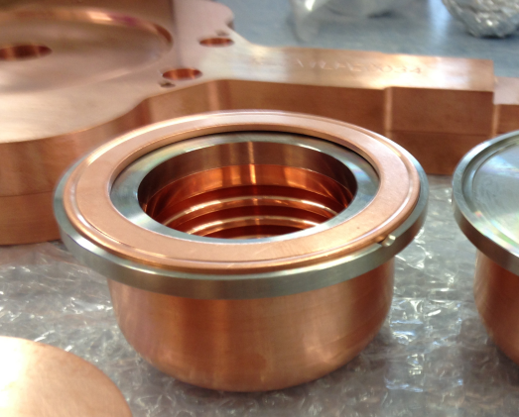
PETS “On-Off” mechanism
The breakdowns happen from time to time either in AS or PETS. In order to maintain the overall luminosity of the machine it is necessary to terminate the RF power locally almost immediately (within 18 ms) after breakdown and engage it gradually afterwards so that it is possible to re-process the related structure. The internal RF reflector allows for such an action.
Reflector
DRAWING
3-chokes chamber

Slide 20
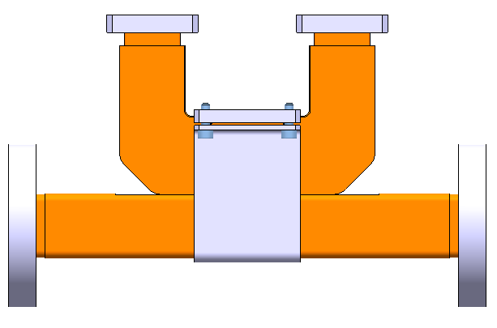
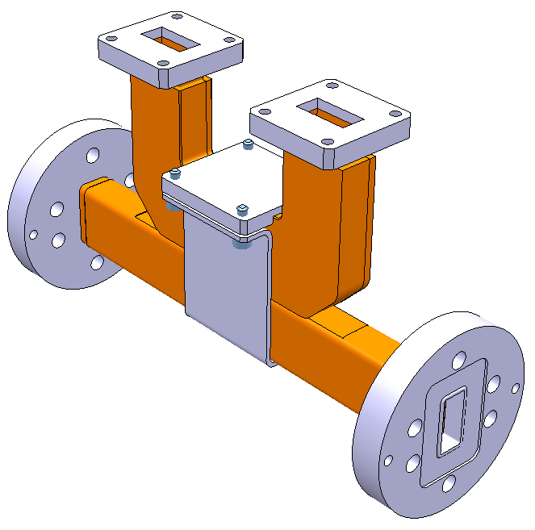
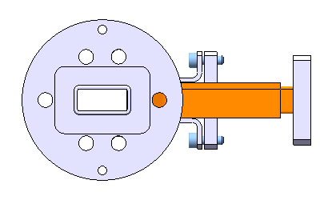
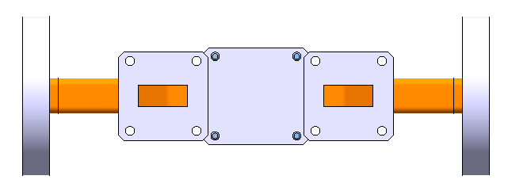
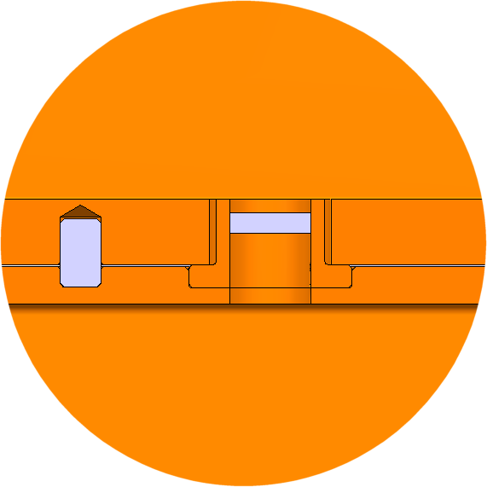
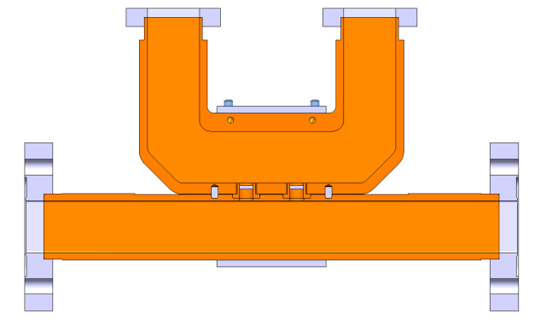
- 60 db Directional Coupler
RF AIR FLANGES
AIR WG
133
RF UHV FLANGES
74
CLAMPING
VACUUM WG
215
CONTACT

Slide 21
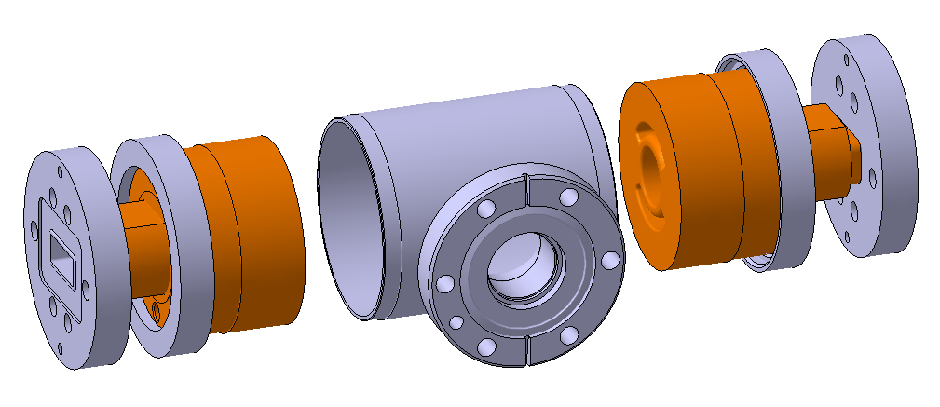
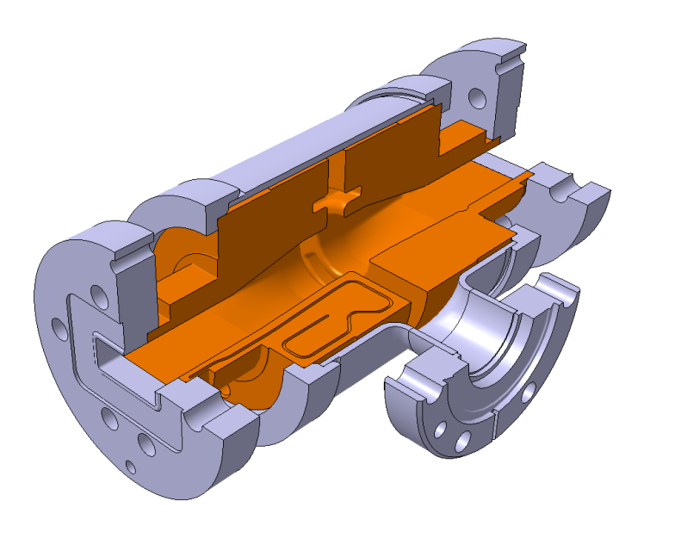
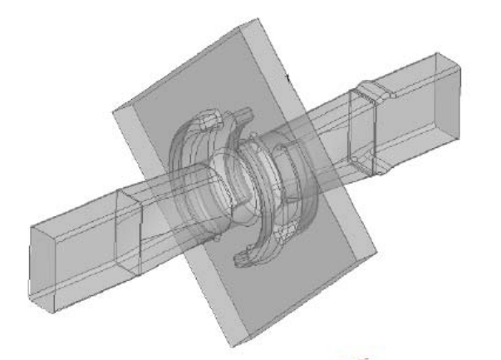
Compact RF Pumping Port
serves the needs to pump long waveguide systems to provide the necessary UHV conditions.
consists of two cavities, each made of two oxygen-free copper halves.
cavities are brazed to the stainless steel cylindrical body containing the vacuum port.
pumping interface is the ultra-high vacuum CF flange.
RF network interfaces are WR90 RF vacuum flanges (SLAC or CLIC design).
RF INTERFACE FLANGE
TAPERS
VACUUM PORT (CF FLANGE)
RF- design

Slide 22
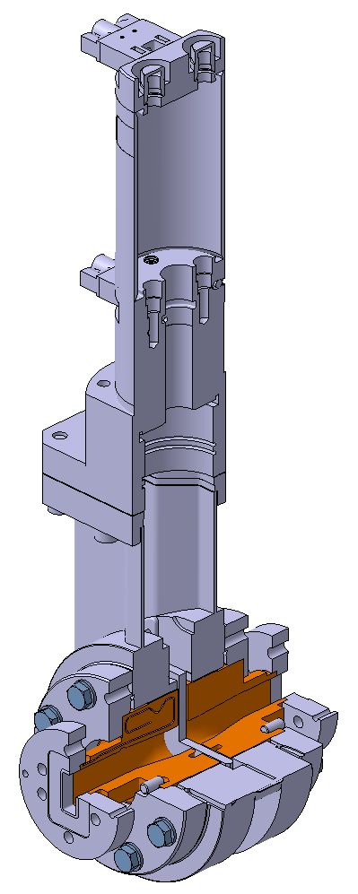
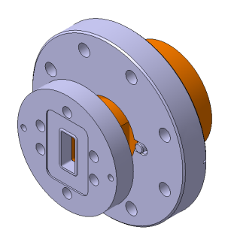
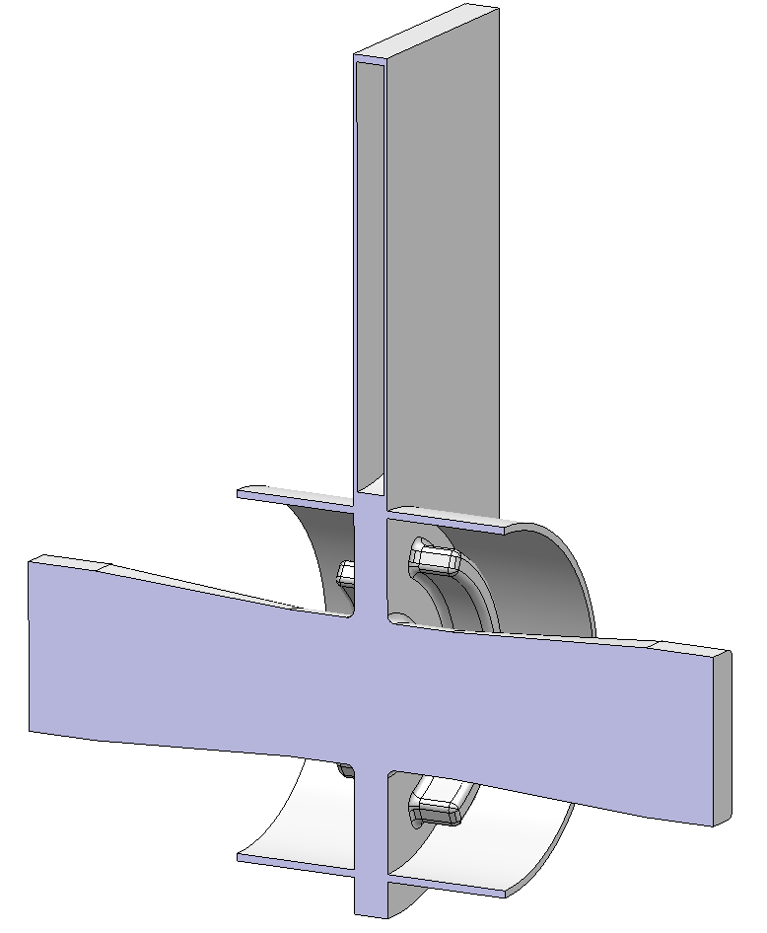
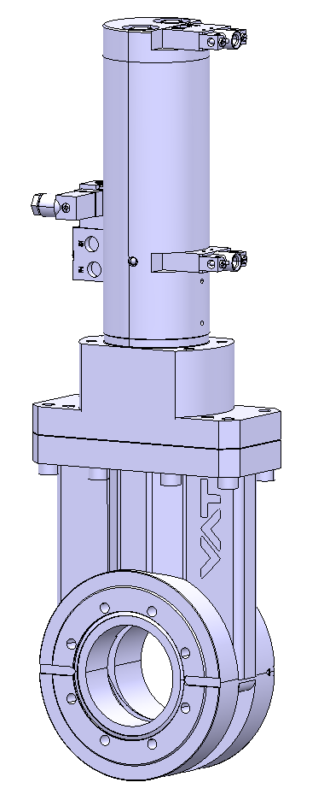
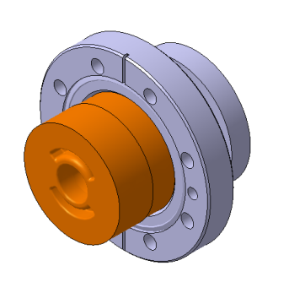
RF Vacuum Gate Valve
allows 100 MW RF power transmission through
used to avoid a ventilation of the whole system during maintenance or replacement of the devices
RF cavities consist of two halves made of oxygen-free copper
vacuum interconnections between valve and cavities are performed by ultra-high vacuum CF flanges
RF network interfaces are WR90 RF vacuum flanges (SLAC or CLIC design)
VACUUM GATE VALVE
TAPERS (REMOVABLE)
Taper (right) assembly
Gate Valve
RF-Design
RF INTERFACE (x2)
Taper (left) assembly

Slide 23
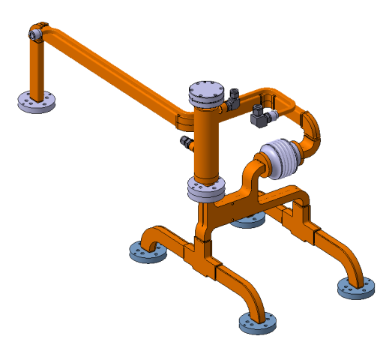
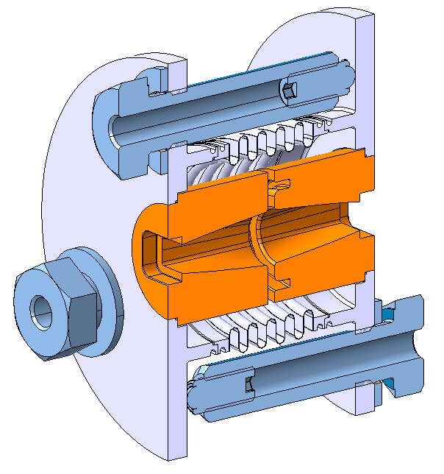
Choke Mode Flange
from
PETS
double-sector
choke flange
to AS
In CLIC the important requirement is the need for independent transverse alignment (of about ±0.1 mm) of the two linacs during machine operation. To avoid the mechanical stresses in a waveguide network we suggested using the double-sector choke-mode flange. This device allows for the electrically contact-free connection between the waveguides and possibility to align transversally the two waveguides without introducing any RF phase errors. The prototype of such a device is now under engineering design optimization.

Slide 24
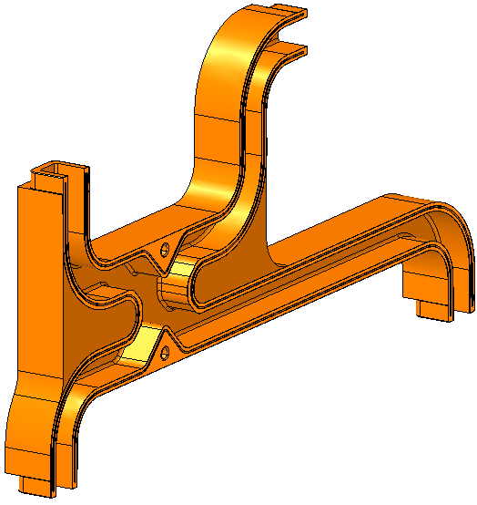
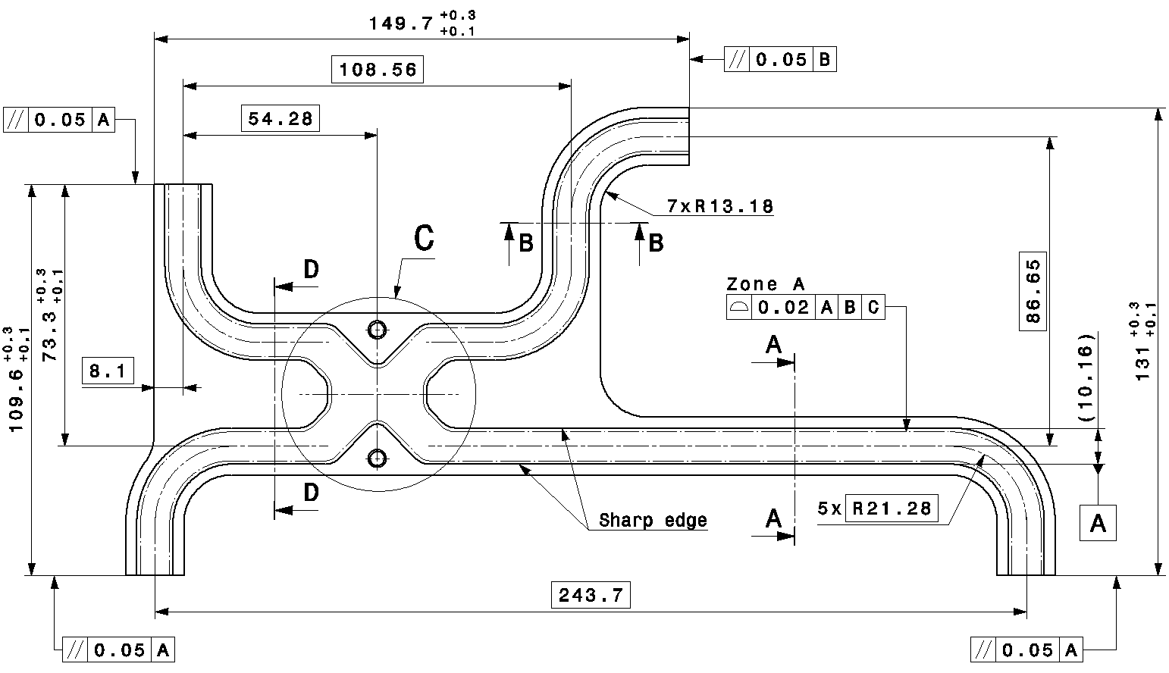
Hybrid
from
PETS
COMPACT
LOAD
AS 2
AS 1

Slide 25
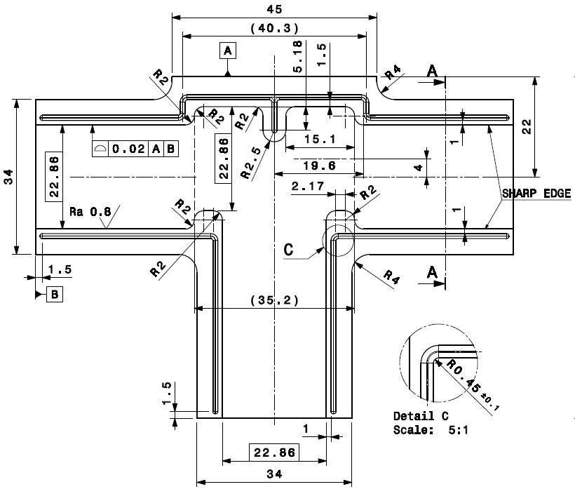

Splitter

Slide 26


Qualification process at CERN

Slide 27
ACKNOWLEDGEMENT
Many thanks to all
“CLIC Module Working Group”
members at CERN for their contribution !

Slide 28
Thank you all
for your attention!

Slide 29




BACKUP MAIN BEAM QUADRUPOLE
MBQ Type 1
prototype
under tests
MBQ Type 4 prototype assembly
CLIC MB Quad. Main parameters

Slide 30

BACKUP MAIN BEAM QUADRUPOLE

Slide 31





BACKUP MODULE TYPES
CLIC Module Type1
(3 %)
1 pair of AS replaced by MB Quadrupole
Standard Module
73 %
Module Type 3
9 %
Module Type 2
12 %
Module Type 4
3 %
Standard Module (L = 2010 mm)
Drive Beam (100 A)
4 PETS, 2 Quads with BPM
Each PETS feeds 2 AS
Main Beam (1 A)
8 acc. structures
MB filling factor: 91%
+ special modules (damping region, modules with instrumentation and/or vacuum equipment)

Slide 32


BACKUP AS
BACK
TO
SLIDE 7

Slide 33


BACKUP PETS OCTANT
BACK
TO
SLIDE 11

Slide 34

BACKUP “On-Off” 3-chokes chamber
BACK
TO
SLIDE 18

