Slide 1
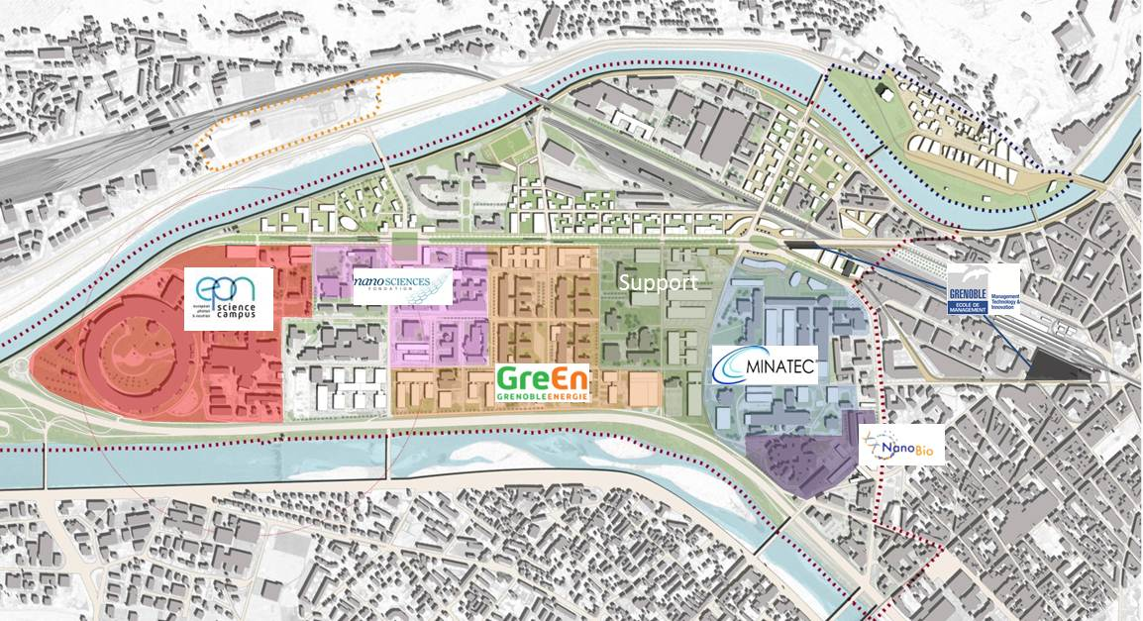
An ambitious science and technology programme
The objectives
1

Slide 2
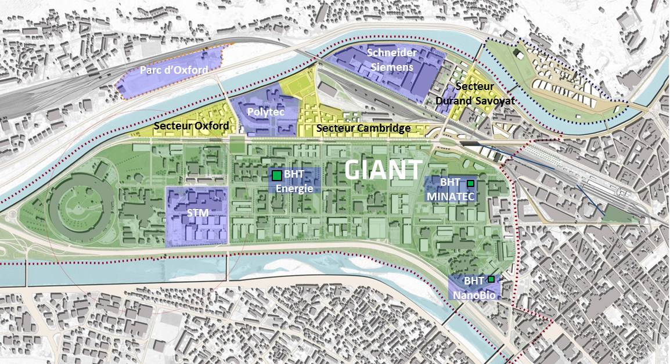
Urban project
Grenoble Presqu’île
A total capacity of over 800 000 m² to be built in the next decades: one of the 3 biggest urban development operations in France
Industry
Housing, shops, leisure facilities and transport infrastructure
GIANT Research and Education buildings
2

Slide 3
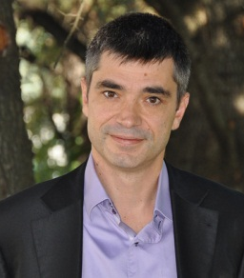
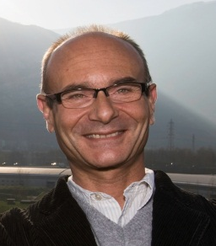
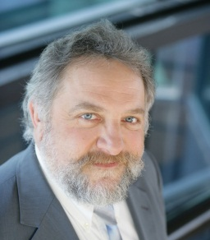
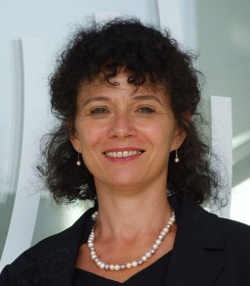
GIANT Alliance
Governance & organisation
GIANT Council: Presidents and Directors of the 8 founding members
in charge of strategic orientations and budgets approval
Jean Therme
Jérôme Vitré
Stephen Cusack
Francesco Sette
Thierry Grange
Brigitte Plateau
Andrew Harrison
Patrick Lévy
1 coordination group:
in charge of preparation of projects for the Council
6 thematic coordination working groups:
International, Scientific, Economic, Communication, Logistics, Campus life and training
Development of action plans
Budgets
3

