Slide 1
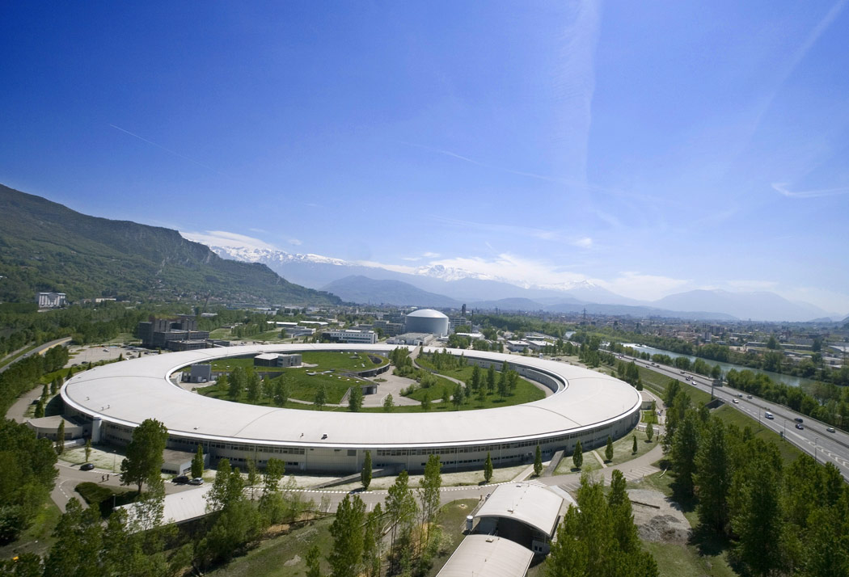
NETHERLANDS@GIANT 25 - 27 June 2013
Netherlands@Giant 25 - 27 June 2013 – J-M. Georgoux

Slide 2
ESRF Purchasing Procedures
Purchasing Forecasts
ESRF Key Contacts
Netherlands@Giant 25 - 27 June 2013 – J-M. Georgoux

Slide 3
The ESRF’s Purchasing Service is part of the Administration Division.
It intervenes as a Support Group to all ESRF Divisions.
The Purchasing Service is responsible for the whole purchasing procedures according to the Council’s regulations in force.
Netherlands@Giant 25 - 27 June 2013 – J-M. Georgoux

Slide 4
Purchases exceeding 50 k€ are subject to Calls for Tender.
Announcement of calls for tender:
The ESRF is not subject to the publication of calls for tender as for public institutions.
Calls for tender announcements are despatched to all Purchasing Advisors.
Invitation to tender:
Suppliers proposed by Purchasing Advisors are invited to compete
Calls for tender are more often despatched by E-mail, or can be downloaded.
Opening of Tenders
Reception of offers is recorded during a Tender Board meeting.
The Tender Board checks that tenders are in conformity with tender rules.
Netherlands@Giant 25 - 27 June 2013 – J-M. Georgoux

Slide 5
Evaluation of tenders:
All aspects of the conforming tenders are evaluated during a Tender Commission.
The Commission compares and ranks the conforming offers.
The Tender Commission provides Minutes, with a recommendation for a supplier. Its conclusions are submitted to the Director General for approval.
"Juste retour" is taken into account during the evaluation of offers.
Netherlands@Giant 25 - 27 June 2013 – J-M. Georgoux

Slide 6
In the case of a conforming offer from a poorly balanced country, within a margin value of 15% compared to the best value for money offer, this bidder is given the opportunity to align its price.
If the supplier accepts to align his price to the best value for money offer, the Contract is awarded to him.
Purchases :
with more than 75% of manpower
related to utilities (water, gas …)
subject to regulatory existing frameworks
are not considered for “Juste retour”, as well as purchases not practicable within International calls for tenders.
Netherlands@Giant 25 - 27 June 2013 – J-M. Georgoux

Slide 7
Recommendations for Calls for Tender
Return our acknowledgment document duly completed ASAP ;
Send your offer to the Purchasing Service only according to the deadline;
Specify your company name and the reference of our call for tender on the outside of your offer ; and comply to the double envelope procedure for CFTs above 300 k€.
Supply all required information, respecting the number of copies requested ;
Send back the Country of Origin Table, and the completed Price Breakdown Pro-forma duly signed.
Return our specifications initialled when agreed by yourself, or comment it.
Late, faxed or E-mailed offers are rejected.
If you decline, do not hesitate to send documentation about your company.
Netherlands@Giant 25 - 27 June 2013 – J-M. Georgoux

Slide 8
Average timescale for a Call for Tender
To+18 weeks
Or
To+22 weeks
To+20 weeks
Or
To+24 weeks
To
To+4 weeks
To+6 weeks
To+10 weeks
To+12 weeks
To+14 weeks
Formulation
of the need
to the
Purchasing
Advisors
(P.A.)
Opening
Of
Offers
PC¹
Approval
Suppliers
Proposed
by the P.A.
Invitation
To
Tender
Evaluation
Of
Tenders
Directors
Meeting
Award
The
Contract
Council²
Approval
NOTE
¹ 500 k€ < Purchases< 5000 k€ : Purchasing Committee Approval
² 5000k € < Purchases : Purchasing Committee + Council Approval
In case of a prequalification exercise, above timescale can be extended by 12 weeks.
Netherlands@Giant 25 - 27 June 2013 – J-M. Georgoux

Slide 9
CFTs in progress as at 30 April 2013
(14 200 k€)
Netherlands@Giant 25 - 27 June 2013 – J-M. Georgoux

Slide 10
Recommendations for Contracts
Do not forget to communicate regularly about progress.
If a problem occurs, please tell us.
Do not deviate from specifications without ESRF’s prior written approval.
Do not try to make repair without receiving formal ESRF approval.
You must comply with the contractual planning. If you are late, please tell us.
Netherlands@Giant 25 - 27 June 2013 – J-M. Georgoux

Slide 11
Purchasing Forecasts until end 2015
Sample distribution and transfer system
UHV surface preparation and analysis module
Mirrors
Vacuum Chambers
Safety lead hutches
Detectors
Replacement of storage ring roof
Computers (Network access control)
Monochromators
Transfocators and various optical elements
Netherlands@Giant 25 - 27 June 2013 – J-M. Georgoux

Slide 12
UPgrade Phase II
Period 2015-2020
Magnets and Power Supplies
Vacuum system
Storage Ring Infrastructure
FE modification
RF system
Mechanical supports
Diagnostics and control
Injection straight section
Insertion Devices
Vercors building &services
4 New Beamlines
Beamline enabling Technology
Draft estimated amount without contingency :150 M€
Netherlands@Giant 25 - 27 June 2013 – J-M. Georgoux

Slide 13
Head of Purchasing Service Assistants - contract activity
Jean-Michel GEORGOUX Cécile DE LA FOREST DIVONNE
georgoux@esrf.fr delafore@esrf.fr
Stéphanie LOCQUET
locquet@esrf.fr
Senior Buyers
Caroline PARIS - Civil Engineering & Building,
cparis@esrf.fr - Cryogenic,
- Positioning Supplies,
- Safety Supplies & Services,
- Industrial & Mechanical Subcontracting
Jean-Charles DESHAYES - Computing Equipment and Information Technology
deshayes@esrf.fr - Electrical Engineering and Electronics
- Network Cabling
- Telecommunication
- Optical, X-Ray & Photography Equipment,
Assistant to Buyers
Alice NENCIONI
nencioni@esrf.fr
Netherlands@Giant 25 - 27 June 2013 – J-M. Georgoux

Slide 14
ESRF Key Technical Contacts
Mechanical Engineering: P. Marion marion@esrf.fr
T. Mairs mairs@esrf.fr
Control Command: J-M. Chaize chaize@esrf.fr
Detector & Electronics: J. Morse morse@esrf.fr
ISDD X-Ray Optics : R. Barrett barett@esrf.fr
Building Infrastructure: T. Marchial marchial@esrf.fr
Systems & Communication : B. Lebayle lebayle@esrf.fr
Vacuum Group: M. Hahn hahn@esrf.fr
Management Informatic System: D. Porte porte@esrf.fr
Electrical Engineering: J-F. Bouteille bouteille@esrf.fr
Y. Gouez gouez@esrf.fr
Netherlands@Giant 25 - 27 June 2013 – J-M. Georgoux

Slide 15
We hope that this event
will give us the opportunity
to find new potential suppliers
Netherlands@Giant 25 - 27 June 2013 – J-M. Georgoux

Slide 16
Thank you for your attention
Netherlands@Giant 25 - 27 June 2013 – J-M. Georgoux

