Slide 1


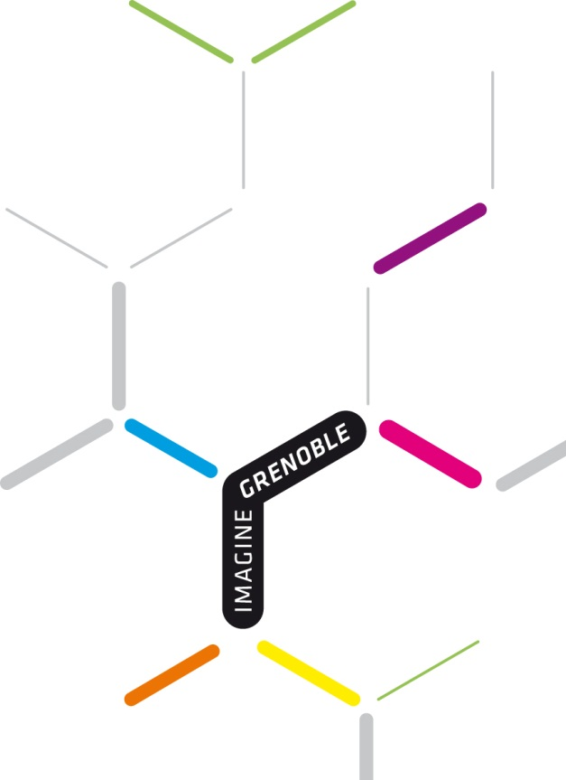
Grenoble Innovation for
Advanced New Technologies

Slide 2

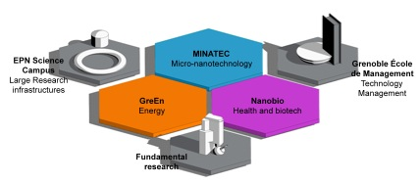



GIANT, a « French MIT »
1. Inspiration & Vision
Building a world-leading campus of excellence
Leading firms
Technology-based innovation and economic development
Institutional support and local infrastructures
in line with major societal challenges
Notes:
The approach by the network and the thoughtful architecture that links the actors together enable an intensification of the speed and the dynamics around innovation.
A sustainability-oriented concept that serves scientific, economic and territorial interests according to its actors
The scale and the ambition of a model that exceed the clusters’ ones.
A network of businesses and influences: informal network which builds narrow and direct connections between education, researchers and firms.
A profitable and direct application of the technological innovations in the industry with particular vigilance on their use.
GIANT is part of « Grenoble Université de l’Innovation », one of the 12 major projects launched by the French government in 2008 in order to reshape the French universities for the 21st century, reinforce their attractiveness and their global visibility.
GIANT stands for Grenoble Innovation for Advanced New Technologies. GIANT is a multi-disciplinary innovation campus that focuses on three key areas :
Information and Communication Technologies
Technologies for renewable energies and low carbon economy
Biotechnologies and healthcare
GIANT will be structured on the basis of six coherent centers of excellence, thereby increasing visibility and attractiveness at a worldwide level :
Three technological centers of excellence in applied research, or “Innovation campus”, built on the model of MINATEC (created in 2005, today one of the major micro-nanotechnology campuses worldwide). Two new centers are being developed: GreEn in energy and NanoBio in health and biotech.
Three transversal centers of excellence : the EPN Science Campus, gathering three major European institutes (ILL, ESRF, EMBL), major fundamental research institutes such as CNRS, and one of the most dynamic business schools in Europe, Grenoble Ecole de Management (GEM).
The three innovation campus will be each connected to a « pôle de competitivité » and eventually to other type of clusters (such as the canceropôle CLARA, connected to NanoBio. In the Energy area, GreEn will be connected to Tenerrdis.

Slide 3
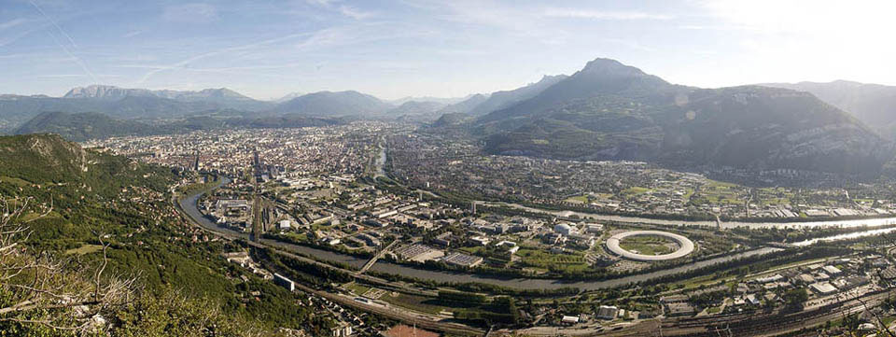
2. Facts and figures
8 partners are drawing the future of Grenoble
  5 Research Centers : CEA, CNRS, EMBL, ESRF, ILL
  3 Universities & Schools : Univ. Joseph Fourier, Grenoble INP & Grenoble EM
With a common vision: be a world leading location for Innovation,
responding to 3 major societal challenges: information, health and energy
Enhancing sustainability and quality of life

Slide 4
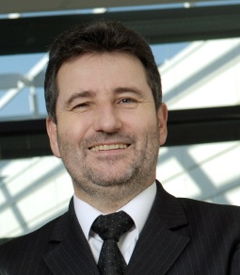
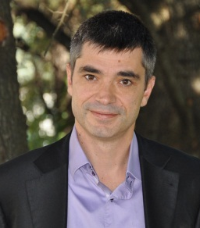
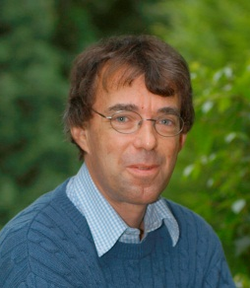
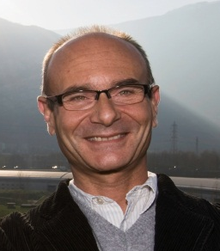
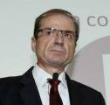
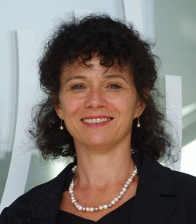
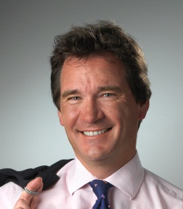
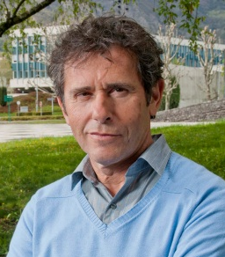








2. Facts and figures
GIANT Alliance
Governance & organisation
GIANT Council: Presidents and Directors of the 8 founding members
in charge of strategic orientations and budgets approval
Jean Therme
Jérôme Vitré
Stephen Cusack
Francesco Sette
Loïck Roche
Brigitte Plateau
Andrew Harrison
Patrick Lévy
1 coordination group: 2 representatives by founding member
in charge of preparation of projects for the Council
6 thematic coordination working groups : development of action plans
International, Scientific, Economic, Communication, Logistics, Campus life and training
4

Slide 5
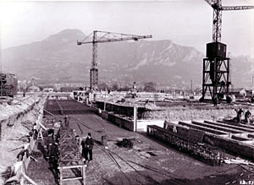
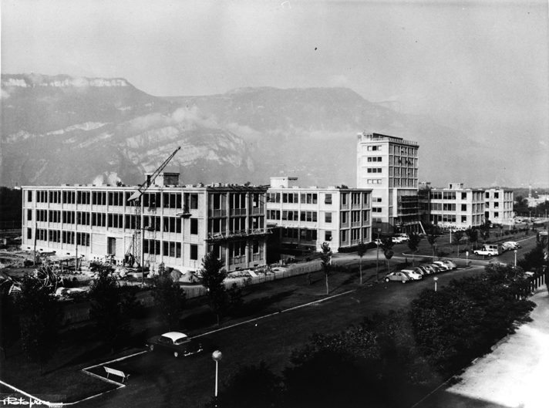
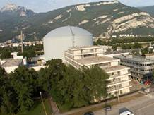
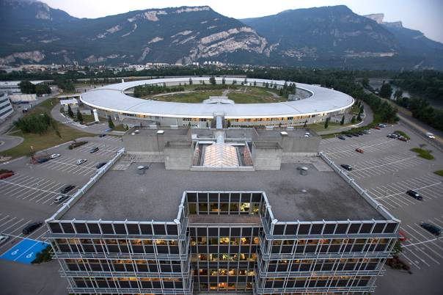
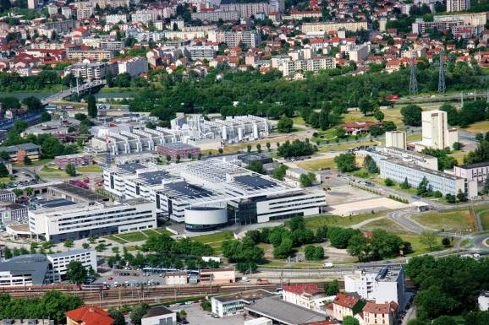
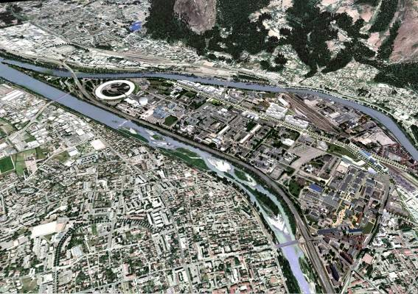
2. Facts and figures
A long tradition of strong cooperation between research / education / industry
1956 CEA (CENG)
1962 CNRS
1967 ILL
European
High Flux Reactor
- and Université Joseph Fourier, Grenoble Institut Polytechnique, Grenoble Ecole de Management …
1988 ESRF
European Synchrotron
Radiation Facility
2005 MINATEC
Micro and
Nano-electronics
2009 GIANT
Innovation
Partnership
5
Notes:
Il y a cinquante ans l'université française vivait un développement universitaire de forte croissance, tant par le nombre des étudiants que par le développement de la recherche.
Louis Weil, Doyen de la faculté des sciences, fut avant l’heure un précurseur des relations de l’université avec l’industrie et avec la cité. Sa conception du domaine universitaire a permis de répondre avec souplesse et efficacité au développement de la recherche et de l’enseignement.
On doit saluer ici ses visions d'avenir pour l'université et ses dons d'anticipation.

Slide 6
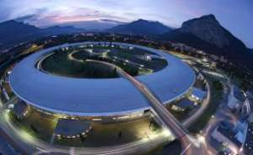
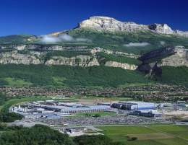
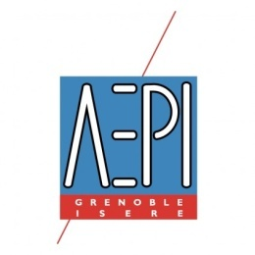
A top research community
2. Facts and figures
23 400 jobs in R&D !
Public research : 15 800 jobs
4 International research centers
9 national research centers: CEA-Grenoble, CNRS, Inserm, Inria, ...
Numerous university labs: UJF, UPMF, Stendhal, Grenoble-INP, GEM…
Private research : 7 600 jobs
STMicroelectronics
Schneider Electric
Lafarge
Constellium
Orange Lab
Bull
Oracle/Sun Microsystems
Air Liquide
Xerox
bioMerieux
HP etc.
Source :

Slide 7
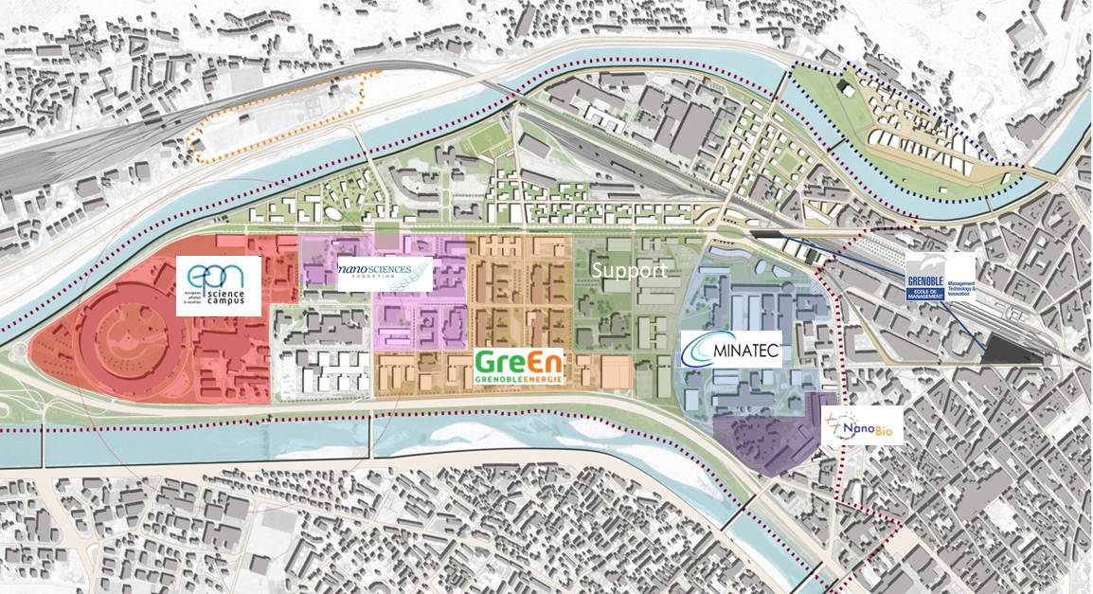
An ambitious science and technology programme
6 centers of excellence – transcending barriers
7

Slide 8
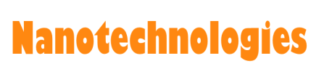
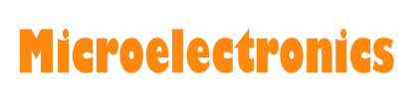

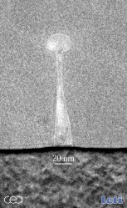



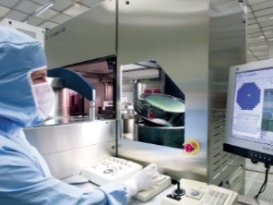
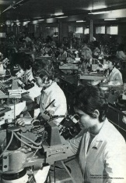

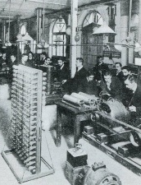
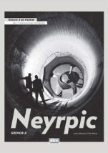





2. Facts and figures
A continuing renewal of electric and electronics industries
1970
1925
1920
1960
1900
1869
A. Berges
Leading firms
Technology-based innovation and economic development

Slide 9
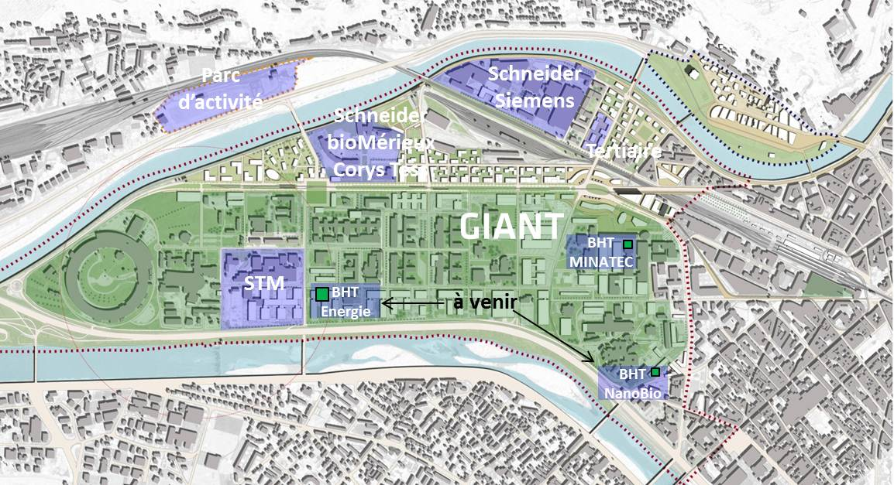






2. Facts and figures
    Today, 40 companies representing more than 5,000 industrial jobs are present on the site. Some examples:
Leading firms
Technology-based innovation and economic development

Slide 10







2. Facts and figures
Among the top public-private investment in France 2010-2025
Listed as « EcoCité », both urban, scientific, academic and economic, located on an area of ​​250 hectares
An investment of 1.3 billion euros over 15 years, divided between
  the scientific and academic GIANT project (600 M €)
  the urban development program (300 M €)
  the infrastructure (400 M €)
850 000 sqm floor area in the forthcoming 15 years, including
  200 000 sqm of commercial property
  100 000 sqm of university buildings
  200 000 sqm of scientific buildings
  25 000 sqm of shops, equipment
  2000 family housing, 3000 students housing
Institutional support and local infrastructures
in line with major societal challenges

Slide 11
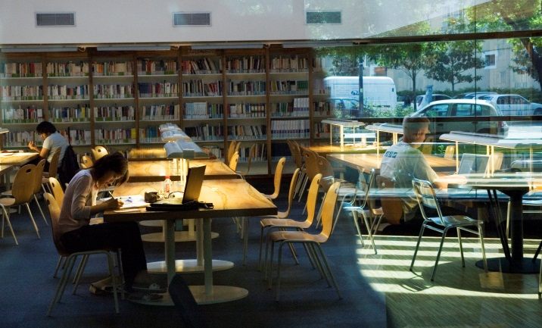
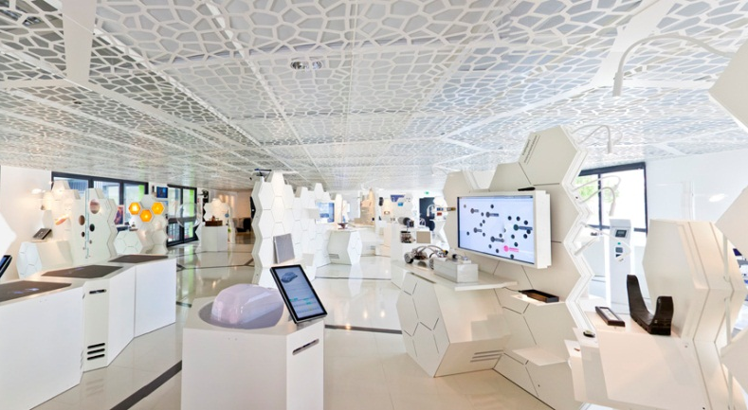
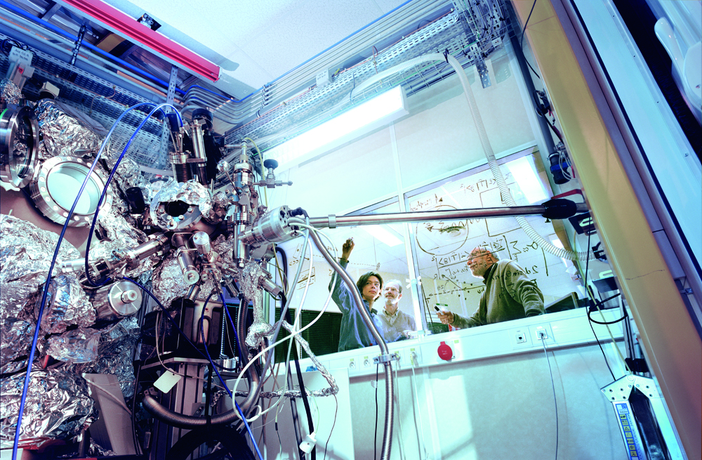
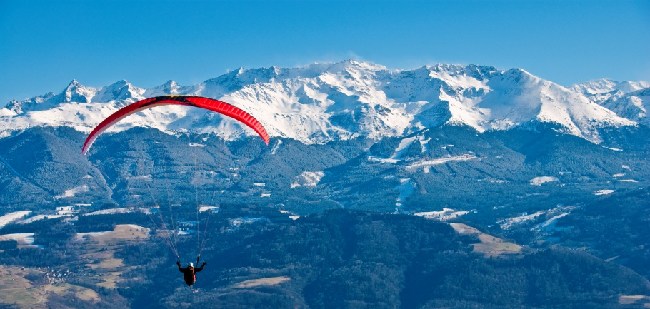
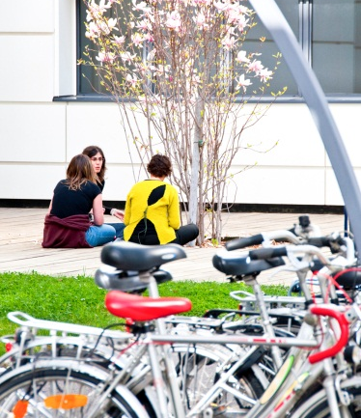
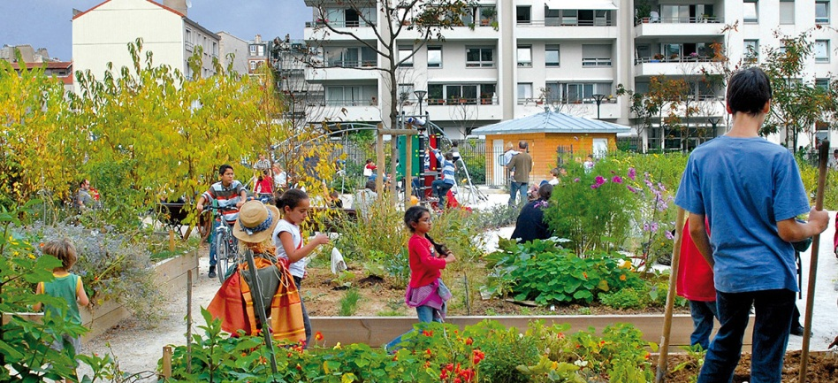
3. Objectives
Attracting world-class researchers, engineers, innovators, professors, and students
Higher education + R&D + advanced industry = wealth and job creation
Quality of life – urban ambition

Slide 12
3. Objectives
Attracting world-class researchers, engineers, innovators, professors, firms and students
GIANT today |  | GIANT tomorrow
6 000 researchers |  | 10 000 researchers
5 000 industrial jobs |  | 10 000 industrial jobs
5 000 students |  | 10 000 students
300 inhabitants |  | 10 000 inhabitants
100 000 visitors annually
5 000 publications annually
500 patents filed annually
€4 billion direct and indirect annual economic impact
50 start-ups launched in past five years

Slide 13

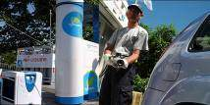
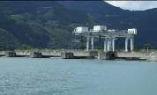
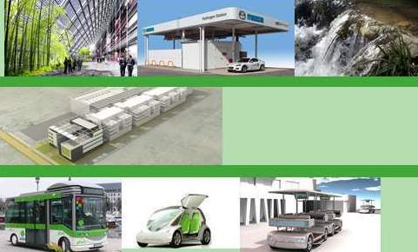
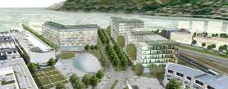
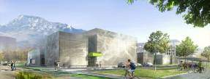
Urban ambition, a carbon-neutral site
3. Objectives
“Greentech” energy production: Solar, hydrogen, hydraulic
Energy efficiency: Low consumption buildings Integrated energy management
Integrated mobility: Electric mobility services
Source :

Slide 14
3. Objectives
An ambitious science and technology programme
Funding and construction schedule
Project investment | 1 300 M€ between 2010 and 2015
Research & Education | 600 M€ | including | MINATEC | 110 M€
 |  |  | NanoBio | 50 M€
 |  |  | GreEn | 125 M€
 |  |  | GEE & RF | 295 M€
Development work | 300 M€
Infrastructures | 400 M€
Funding entities | 19% 24% 19% 5% 33% | State Local government European large scale infrastructures CEA Private
14

Slide 15









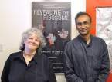





4. Key Assets
A proven track record of excellence
Jean Kuntzmann
1st computing lab
1951
1930
1961
Jean Pomagalski
1st mechanical ski lift
Rudolf Mössbauer,
Physics Nobel Prize
1907
Abel Rossignol
creates the first ski
1817
XVIIIè
1970
Louis Vicat
Artificial cement
Ada Yonath & Venkatraman Ramakrishnan
Chemistry Nobel Prize
Louis Néel
Physics
Nobel Prize
Jacques Vaucanson
automate
2009
1850-
1889
1985
Aristide Bergès
hydro power
Klaus Von Klitzing, Physics Nobel prize
Xavier Jouvin
Glove making industrial process
2007
1980-1990
Joseph Sifakis
2007 Turing prize
Claude Lorius, glaciologist, Blue Planet Prize
Assesses the direct connection between greenhouse gas effect and climate evolution
1987
Alim-Louis Benabid
Neuronal stimulation for parkinson disease
Source :

Slide 16

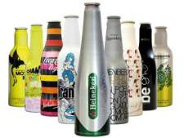
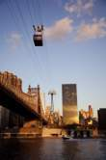






4. Key Assets
A proven track record of innovation
Over ½ of X ray s worldwide realized thanks to detectors designed and produced in Moirans, near Grenoble
Boxal:
the aluminum
bottle
Gorgy Timing : displays the exact time in France and worldwide
Sti Plastics: the smart pill box!
Poma : cable car for public transportation in NY, Brazil, Egypt, China, Russia, …
SOITEC SOI inside the Wii, Sony Playstation, Xbox, …
STMicroelectronics: Orly system in TV set top boxes
Source :
Notes:
Il manque des exemples dans les domaines du logiciel et des énergies
Idées :
Airstar : tournage du Titanic pour faire comme la lumière naturelle
30% des seringues pour vaccins fabriquées à Grenoble par BD → se renseigner
Skis : conçus à Grenoble (voir avec Rossignol)
Ajouter les capteurs d’images CMOS de ST → j’ai les éléments
Turbines de chez Alstom Power
Logiciels : demander à Laurent Julliard, exemple de réalisation 3D → Ingrid ?
Schneider → Ingrid avec Nicolas Leterrier
AirLiquide et fusées → Anne
BioMérieux → Anne
Garder en tête l’idée d’innovation dans les objets les plus simples, utilisés au quotidien pour trouver des exemples
Les produits d’aujourd’hui et de demain

Slide 17
4. Key Assets
AN EFFECTIVE INNOVATION MODEL
Gather a wide variety of actors : the ecosystem approach
  Goals : research centers, training centers, firms, institutions, “linkers” and strength of formal and informal networks
  Skills : researchers, students, teachers, entrepreneurs, institutions
  Cultures : attract international talents, techno-entrepreneurship
  A good location to live
  International connections
2. Create dynamic synergies aligned in a strategic innovation ambition
  Complementarities within the added value innovation chain
  Make actors share resources and work together
  The technological complexity is controlled by the synergies
3. Reduce risk, time & costs of innovation – entrepreneurial mindset
  Strong role of technological platforms and research infrastructures to use the synergies
  Get the support from the local institutions, tax
  Level of public and private investment in the area

Slide 18
THANK YOU FOR YOUR ATTENTION

